Slide 1
WP2: User Modeling, Personalisation & Engagement
Mehdi Elahi & Christoph Trattner
29.09.2021

Slide 2
What
is done?
What
we will do?
Who
we are?

Slide 3
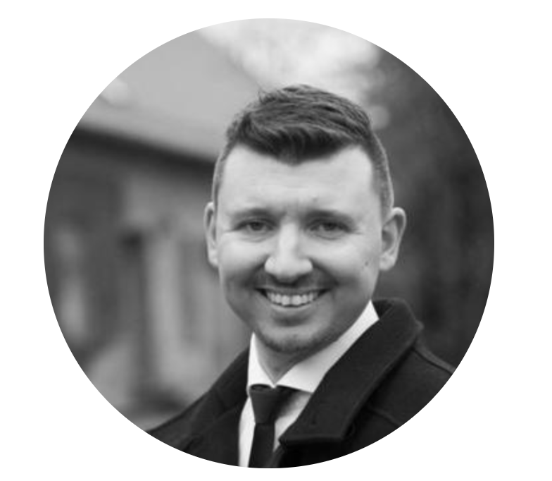
Who We Are?
s00
@WP2
WP Leader:
Mehdi Elahi
(UiB)
WP Co-leader:
Christoph Trattner
(UiB)
Industry Leader:
Lars Skjærven
(TV 2)
WP Advisor:
Dietmar Jannach
(AAU)
s00
PhD Student:
Anastasia Klimashevskaya
(UiB)
PhD Student:
Ayoub El Majjodi
(UiB)
WP Team:
Erik Knudsen
(DIGSSCORE & UiB)
WP Team:
Alain Starke
(UiB)
WP Team:
Krisztian Balog
(UiS)
WP Team:
Helle Sjøvaag
(UiS)
& more

Slide 4
What
is done?
What
we will do?
Who
we are?

Slide 5
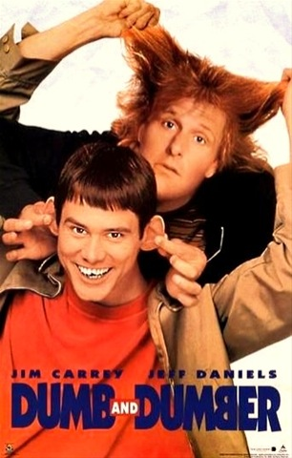
What We Do?
Development of software tools offering novel recommendation & personalisation to support people when making choices.
s00
?

Slide 6
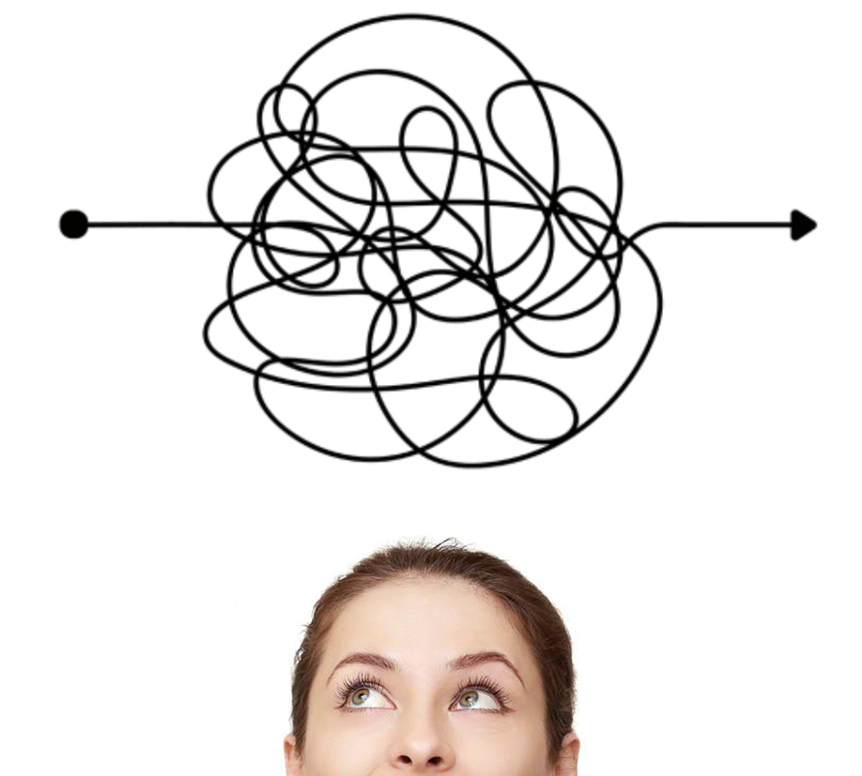
Why Recommendation?
s00
By average, people make around 35000 choices in a single day!
Choices on what to watch, listen, read, play, visit, eat, … ?

Slide 7
Benefits for Business
s00
More than 80% Netflix revenue is made by recommendation.
More than 70% YouTube views is made by recommendation.

Slide 8
Benefits for People & Business!
What is the problem?

Slide 9
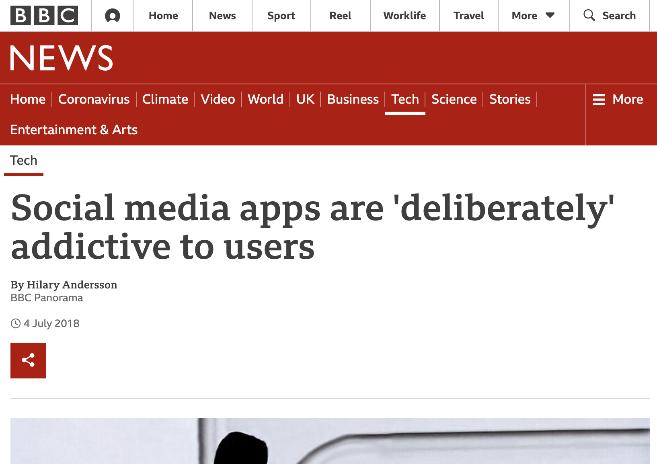
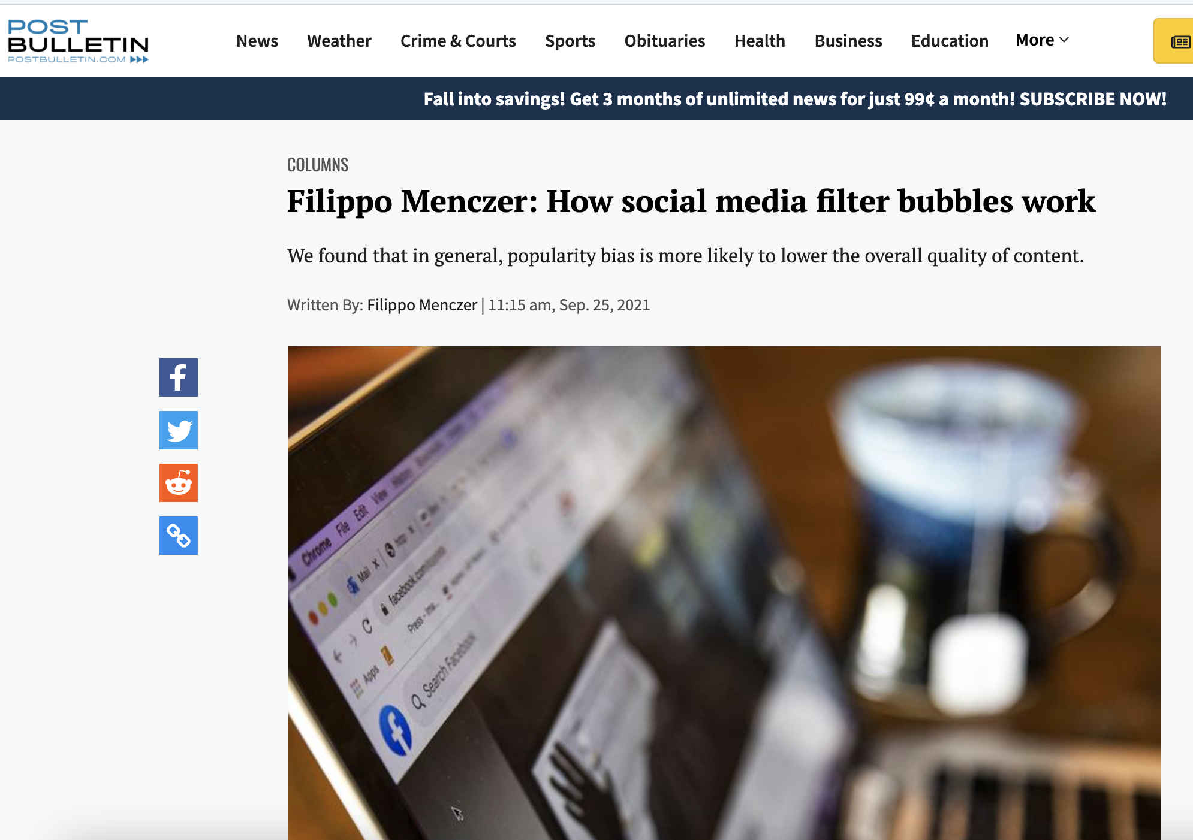
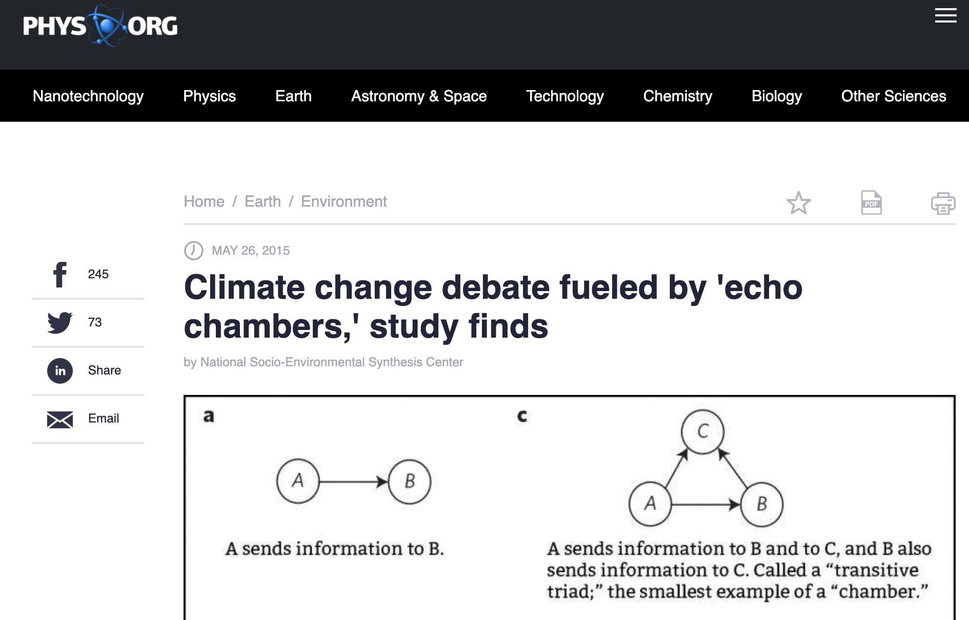
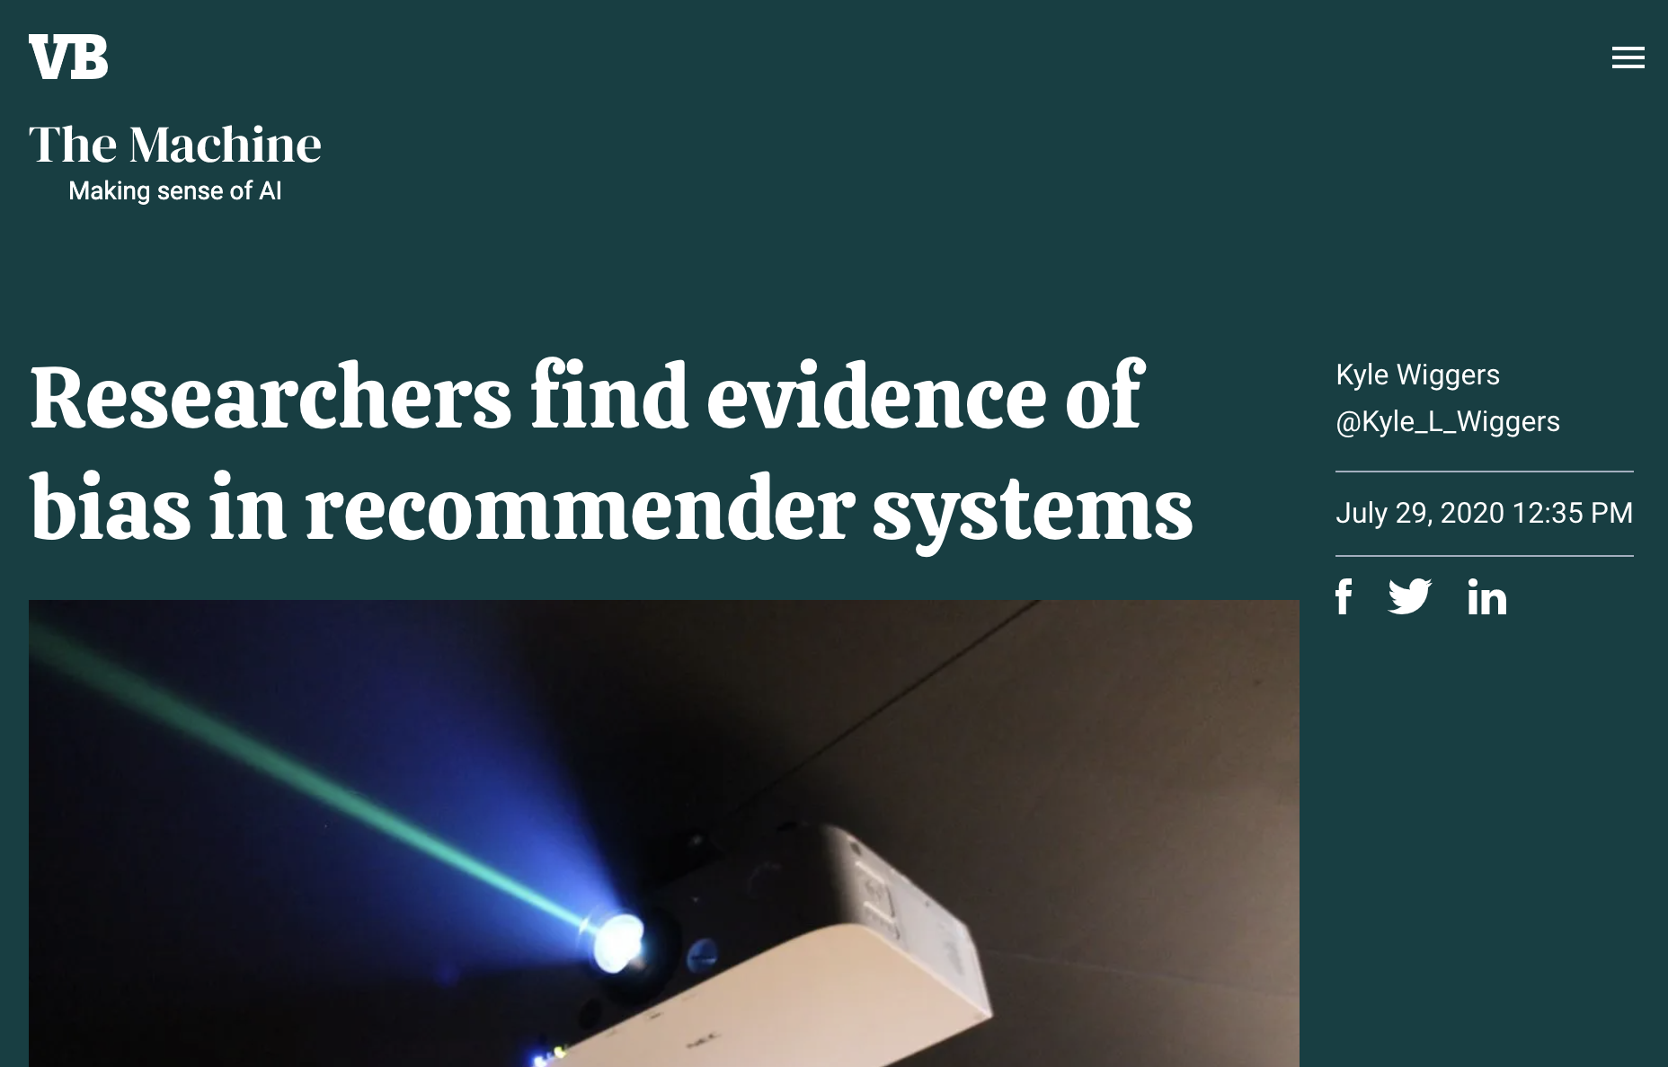
Undesired Effects

Slide 10
Undesired Effects: Popularity Bias
s00
A few examples:
Twitter: less than 1% of popular celebrities attracted 50% of users
Wikipedia: less than 1% of active users contribute to 50% of the posts
Amazon: less than 5% of the active users 50% of the posts
Facebook: less than 10% of active users produced 50% of the posts
Ref: Baeza-Yates, R. (2018). Bias on the web. Communications of the ACM, 61(6), 54-61.

Slide 11
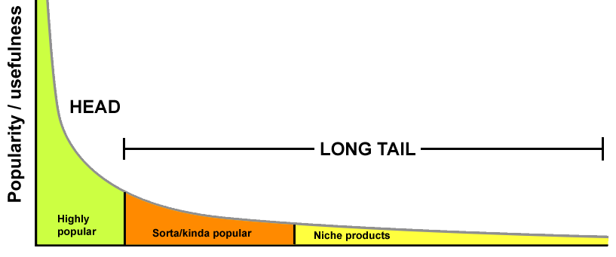
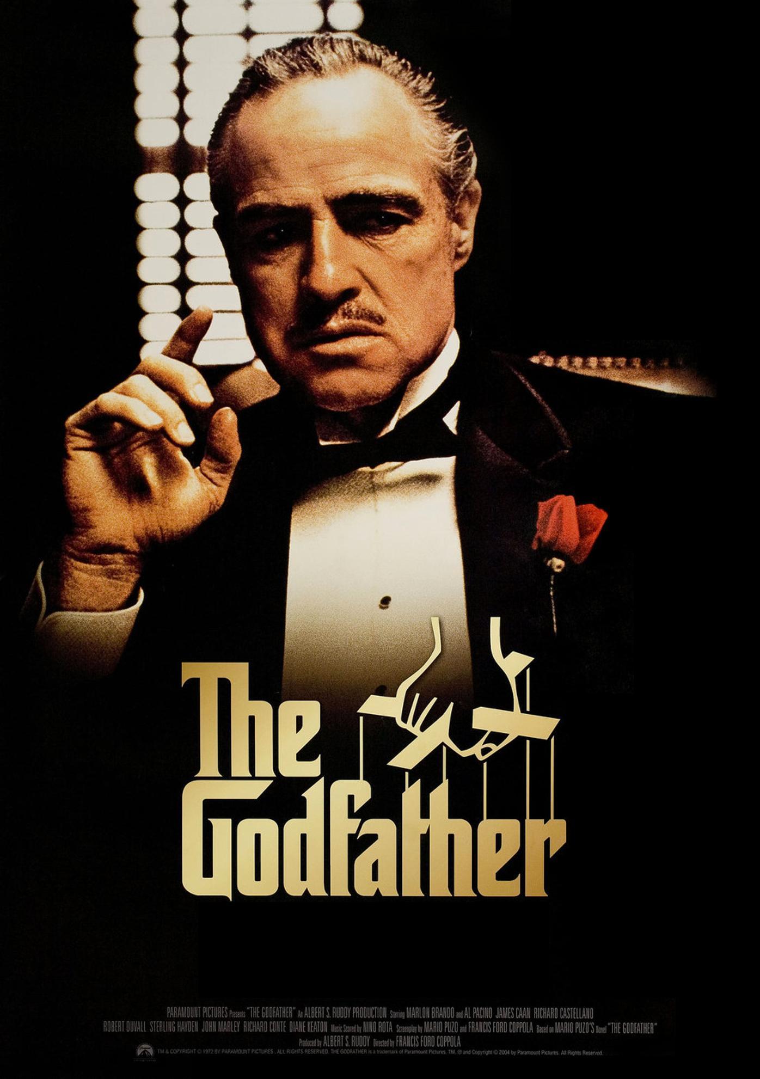
Undesired Effects: Popularity Bias
high
visibility
low
visibility

Slide 12
Solutions: Technical Approaches
s00
Mitigating undesired effects with responsible recommendations :
Diversification to cover a rich spectrum of media content
Fairly modeling media content & users to more expose the niche or minority content to users

Slide 13
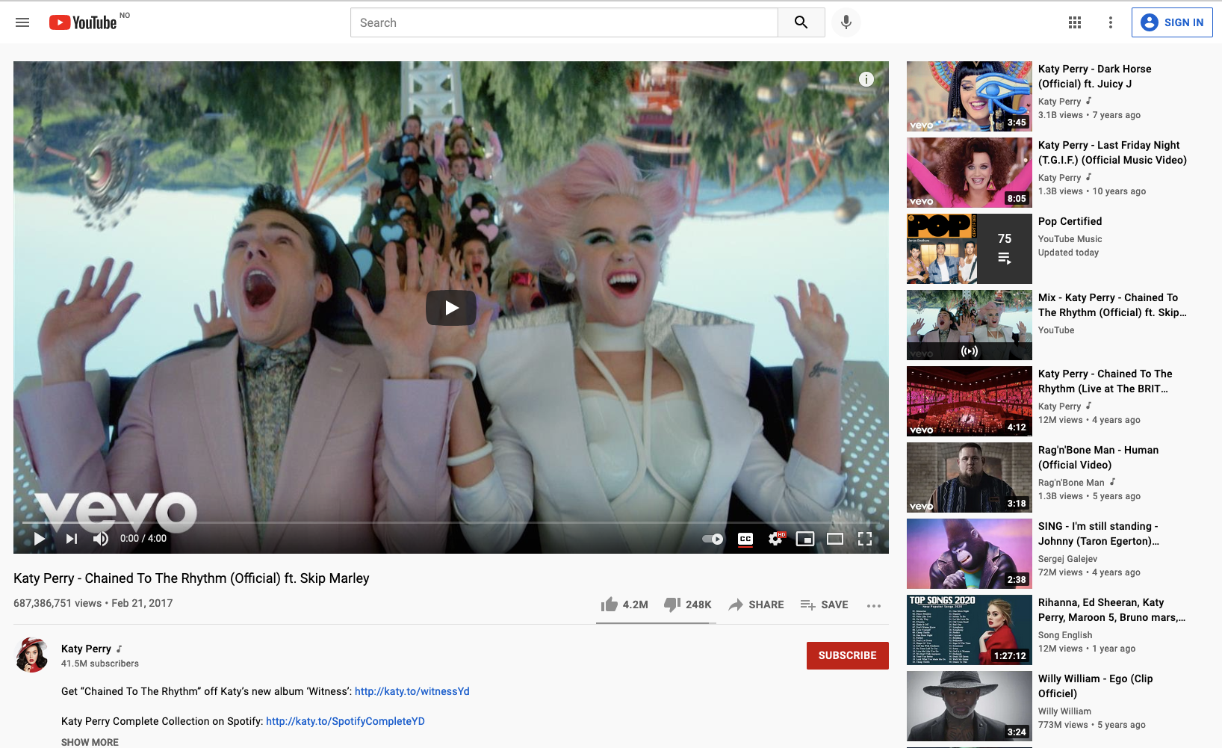
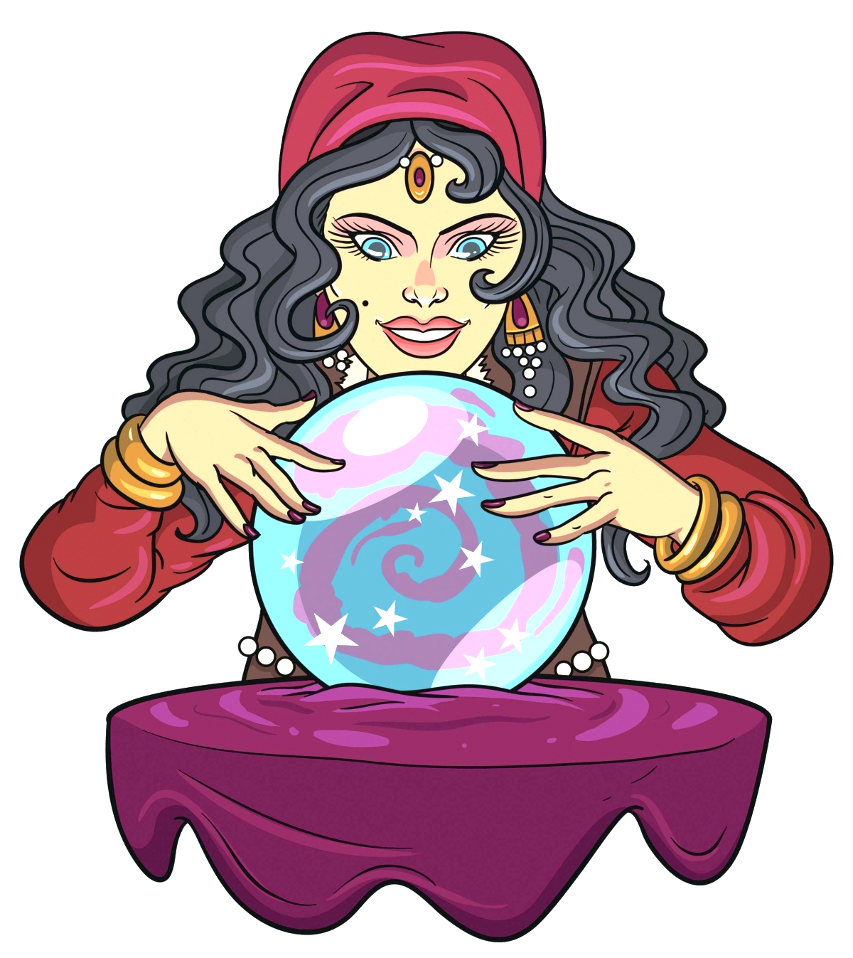
Example of Technical Approaches
AI
Re-ranking recommendation output

Slide 14
What
is done?
What
we will do?
Who
we are?

Slide 15
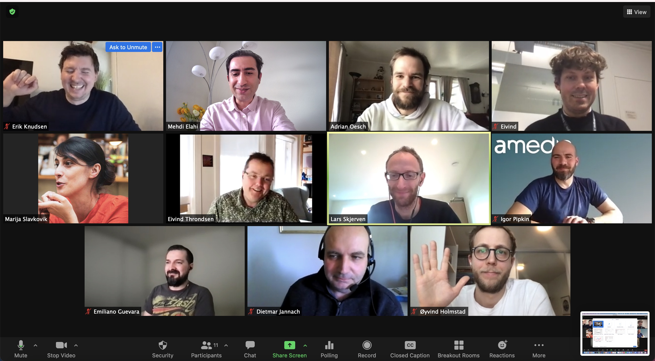
What Is Done?
s00
We have organized
Workshop with partners
Tri-weekly Meetings
Individual Meetings

Slide 16
What Is Done: WP2 Vision Paper
s00
Accepted by AI and Ethics journal (with minor revision)
A journal published by Springer Nature
Surveys:
Undesired Effects of recommendation
Mitigating Solutions

Slide 17
What Is Done: Publications
Journal:
Investigating the impact of recommender systems on user-based and item-based popularity bias (Elsevier IPM, Norwegian Level 2)
Conference:
Beyond Algorithmic Fairness in Recommender Systems (UMAP 2021)
Recommending Videos in Cold Start With Automatic Visual Tags (UMAP 2021)
The Cholesterol Factor: Balancing Accuracy and Health in Recipe Recommendation Through a Nutrient-Specific Metric (RecSys - MORS 2021)
Predicting Feature-based Similarity in the News Domain Using Human Judgments. (RecSys 2021)
Exploring the Effects of Natural Language Justifications in Food Recommender Systems (UMAP 2021)
s00
s00

Slide 18
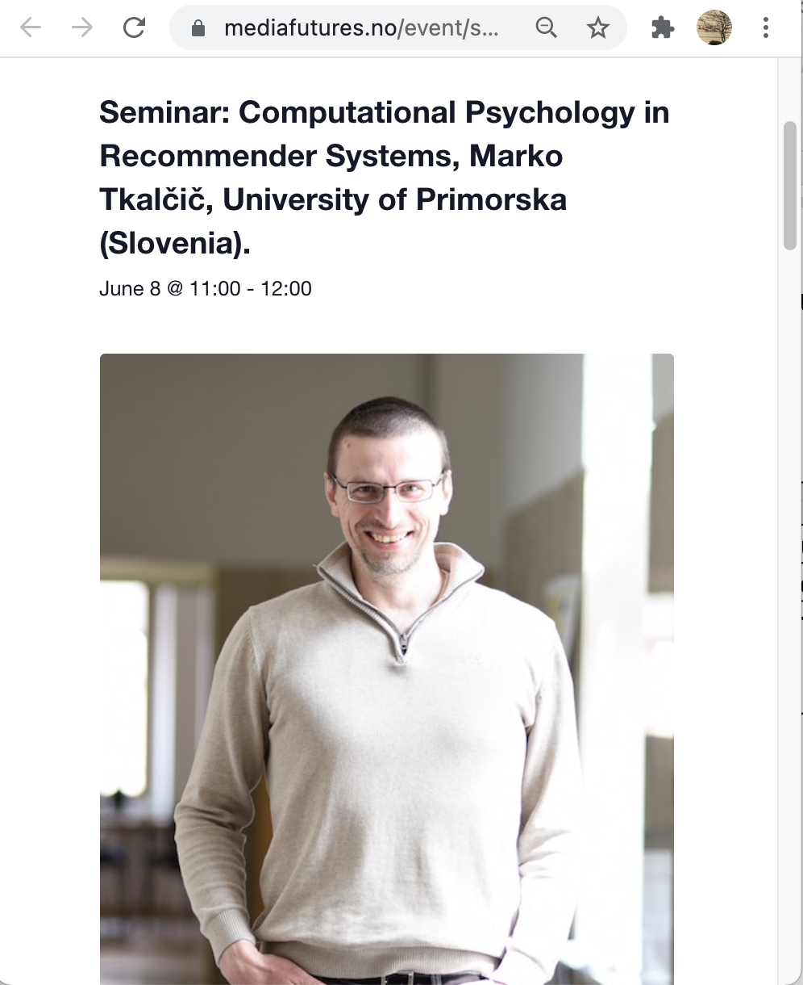
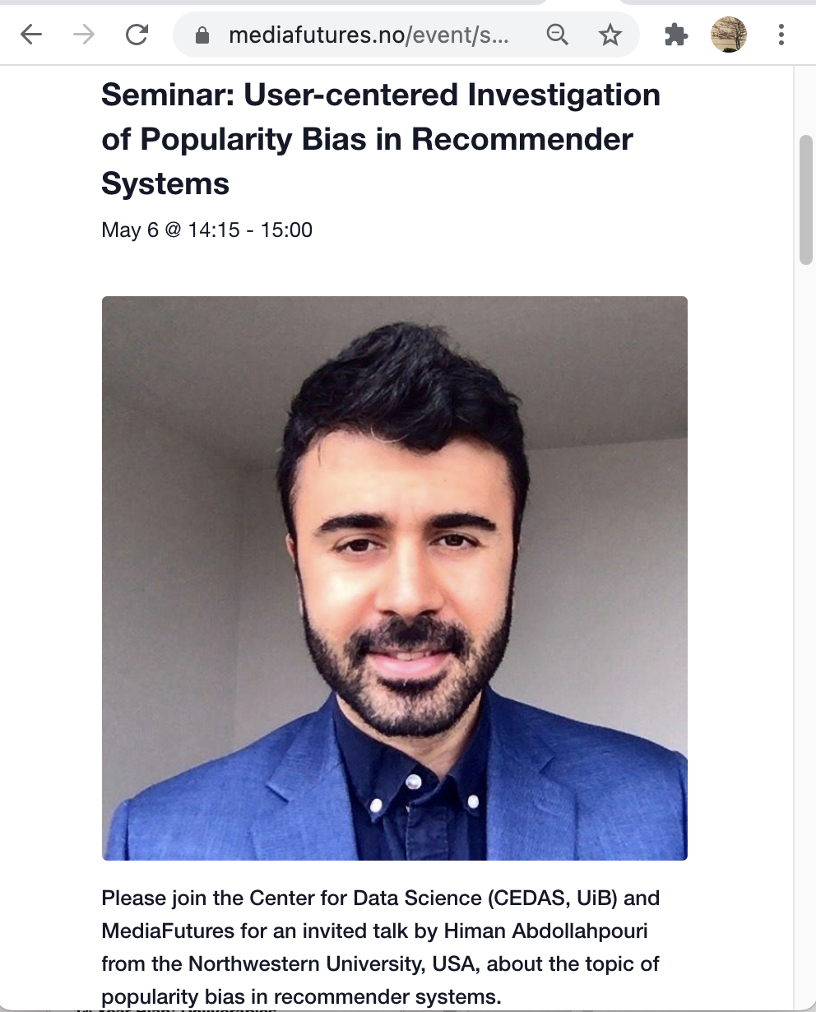
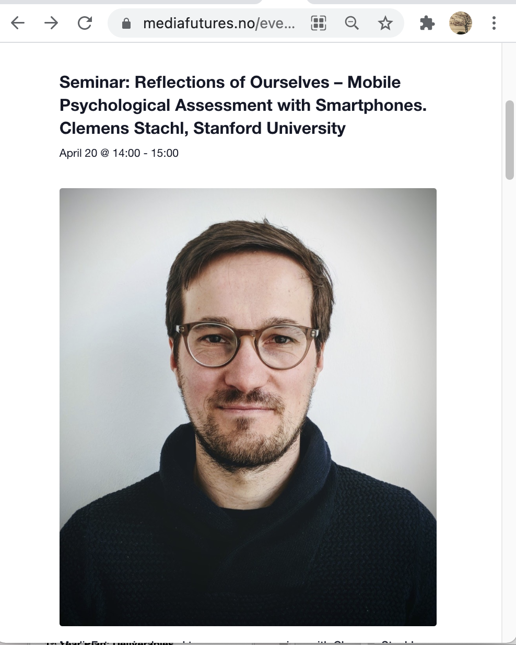
Public Outreach: Public Seminars
s00

Slide 19
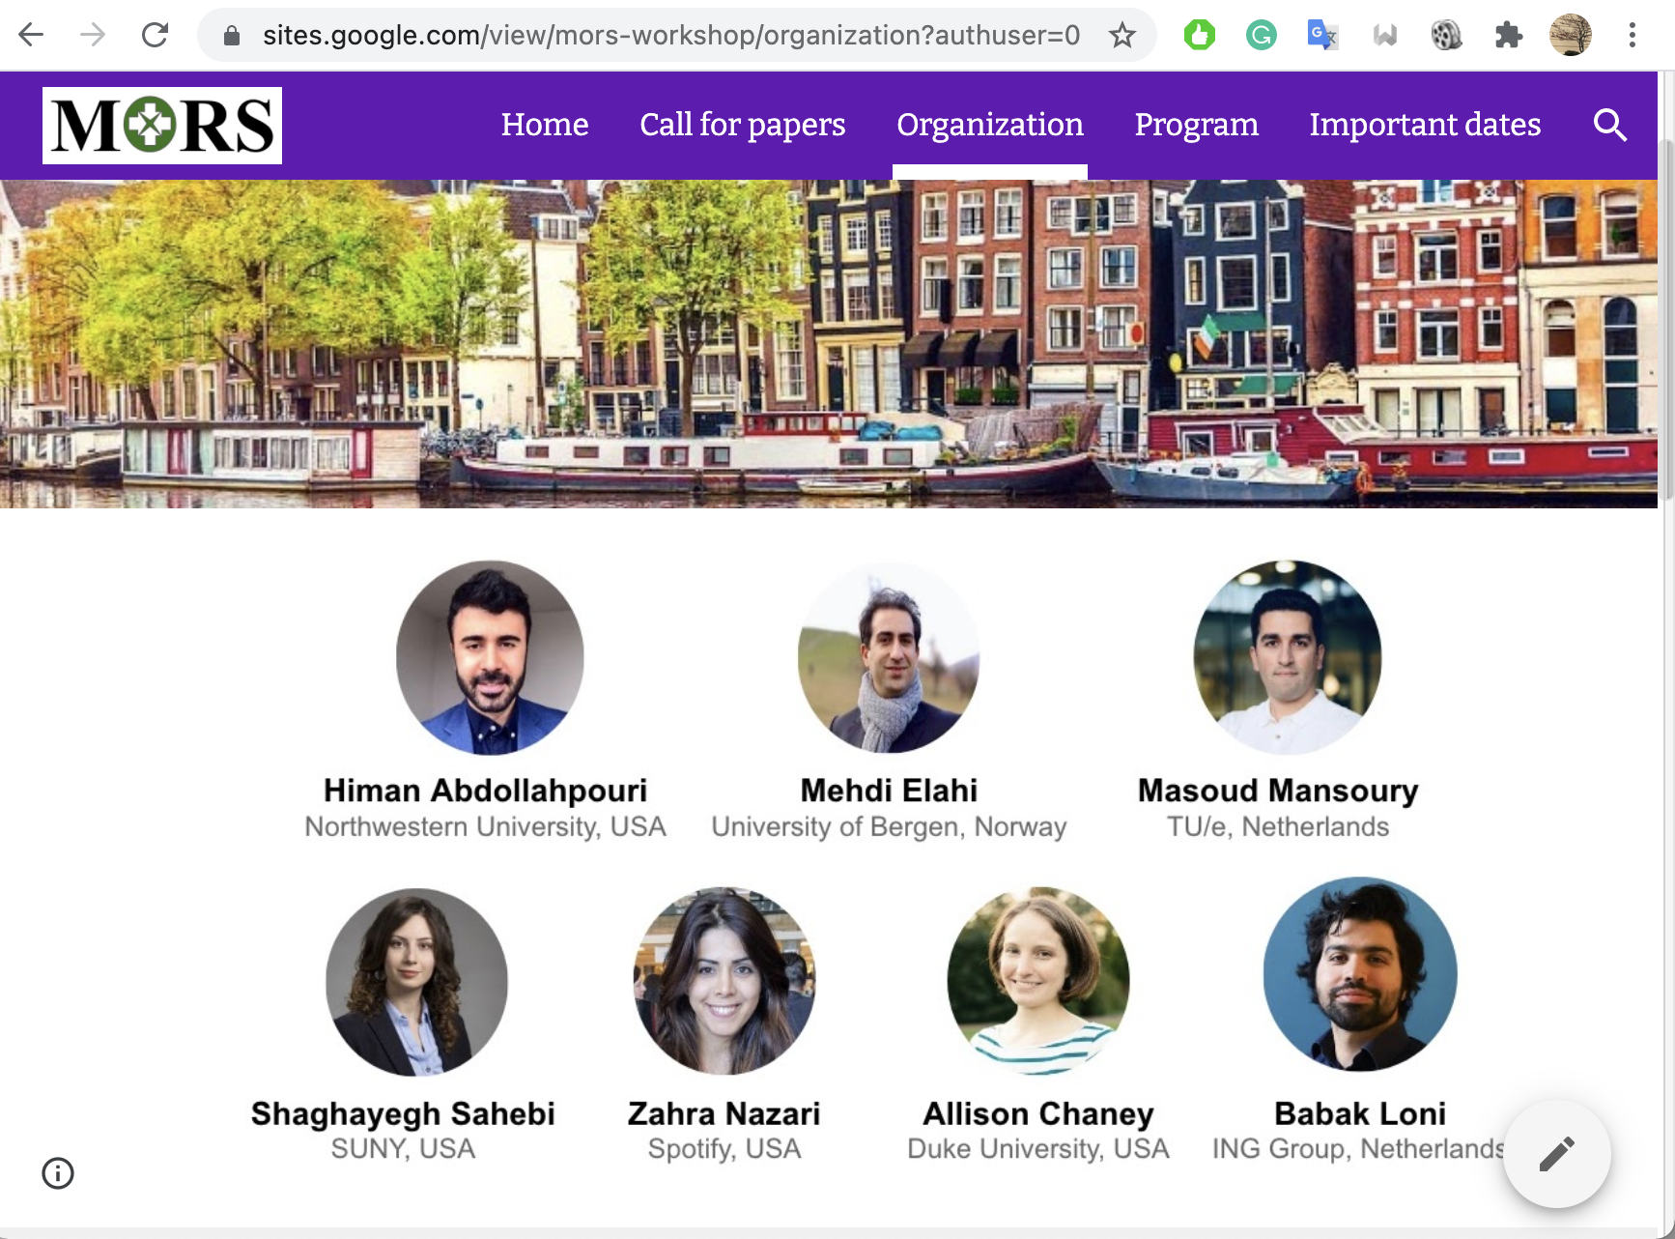
Public Outreach: International Workshop
s00
RecSys 2021
Topmost conference of the field

Slide 20
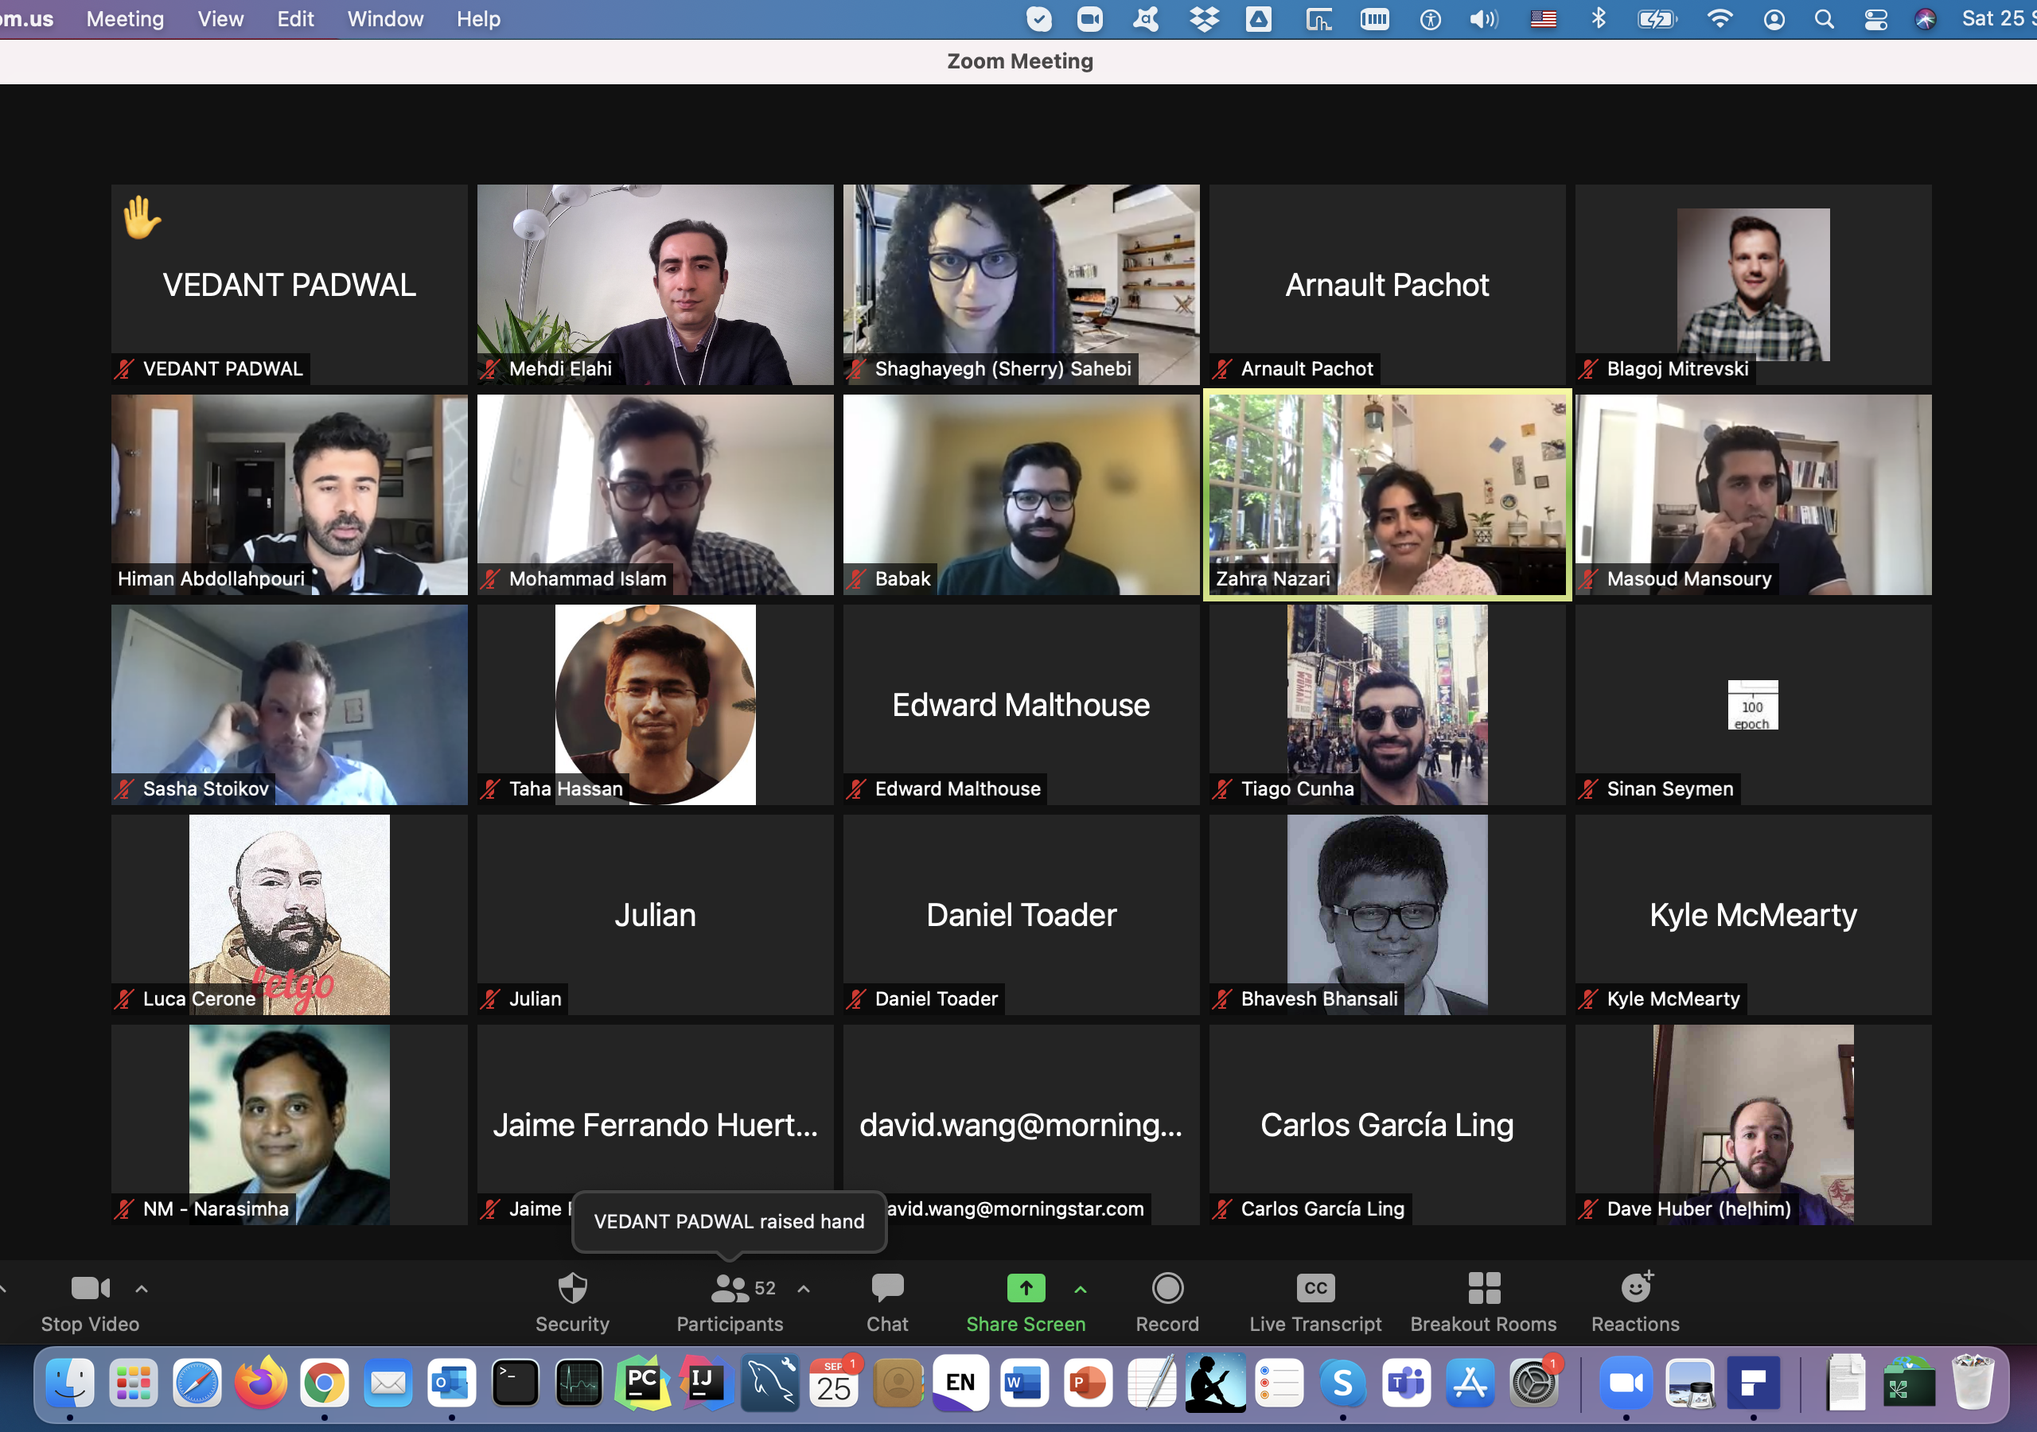
Public Outreach: 70+ Participants
s00
RecSys 2021
Topmost conference of the field

Slide 21
Mehdi Elahi
Christoph Trattner
WP2 Leader
WP2 Co-leader

