Slide 1
Online echo chambers: How do they work and what can we do? Centre Director Prof. Dr. Christoph Trattner University of Bergen
22 July 2011 at Ten: Commemoration and Commitment, 25-27 August 2021, Bergen, Norway
Notes:
Intro narrative: Online echo chambers
Online echo chambers are a big part of our life, in some cases we do not even see them how or where. Everyone heard about echo chambers. Newspapers, politicians and researchers are talking about them, trying to understand them and working against or for them.
Echo chambers are not something what we as consumers or we as producers can avoid, but we can understand them and try to break out from them to avoid certain problems and actions.
Do you think that veganism is one of the answers to climate change? That the oil industry is just the worst? That Greenpeace and Extinction Rebellion's cause can be dedicated as purely good? Or that neo-nazis are …

Slide 2
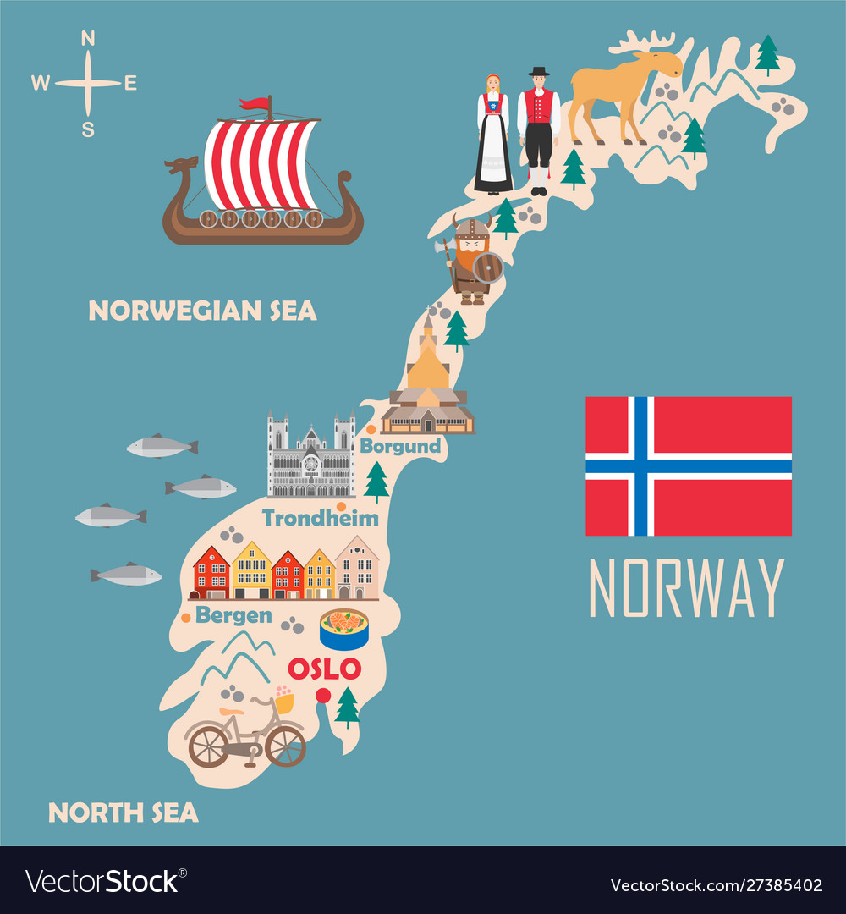
Introduction
Christoph Trattner
Full Professor at University of Bergen
Centre Director at MediaFutures
Originally from Graz, Austria

Slide 3
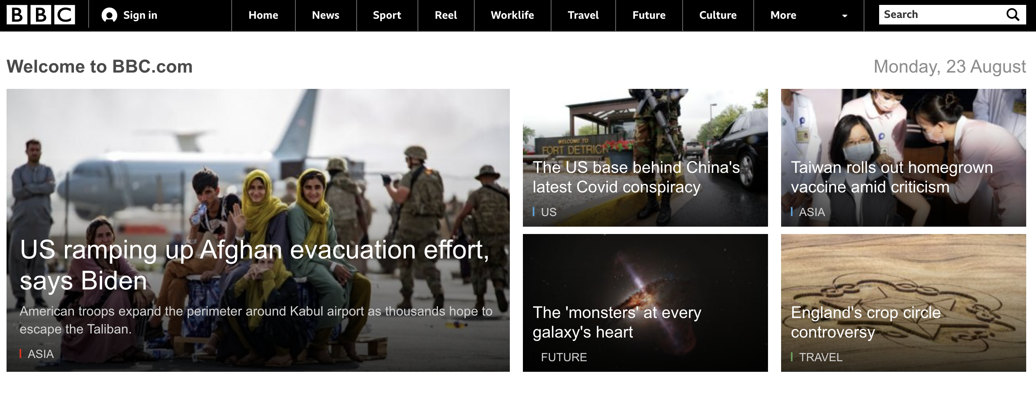
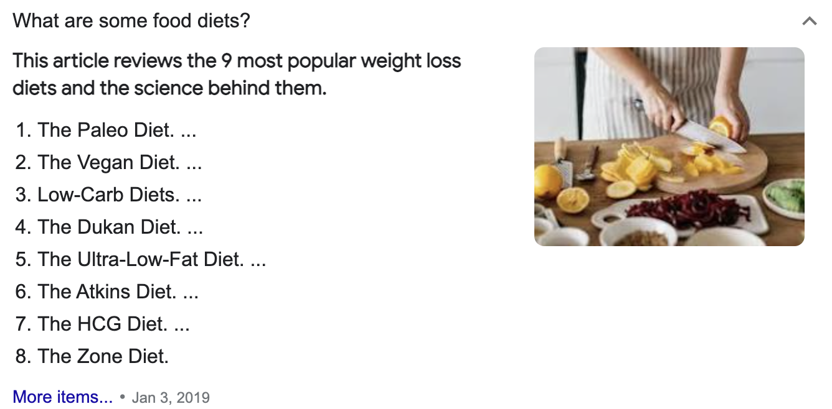
Research
My mission is to improve diets:
Food
Media

Slide 4
This talk
Part 1: What are echo chambers?
Part 2: How do they look & examples?
Part 3: What can we do about them from a technological point of view?

Slide 5
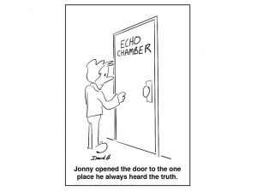
PART 1: What are echo chambers?
Source: Google.com

Slide 6
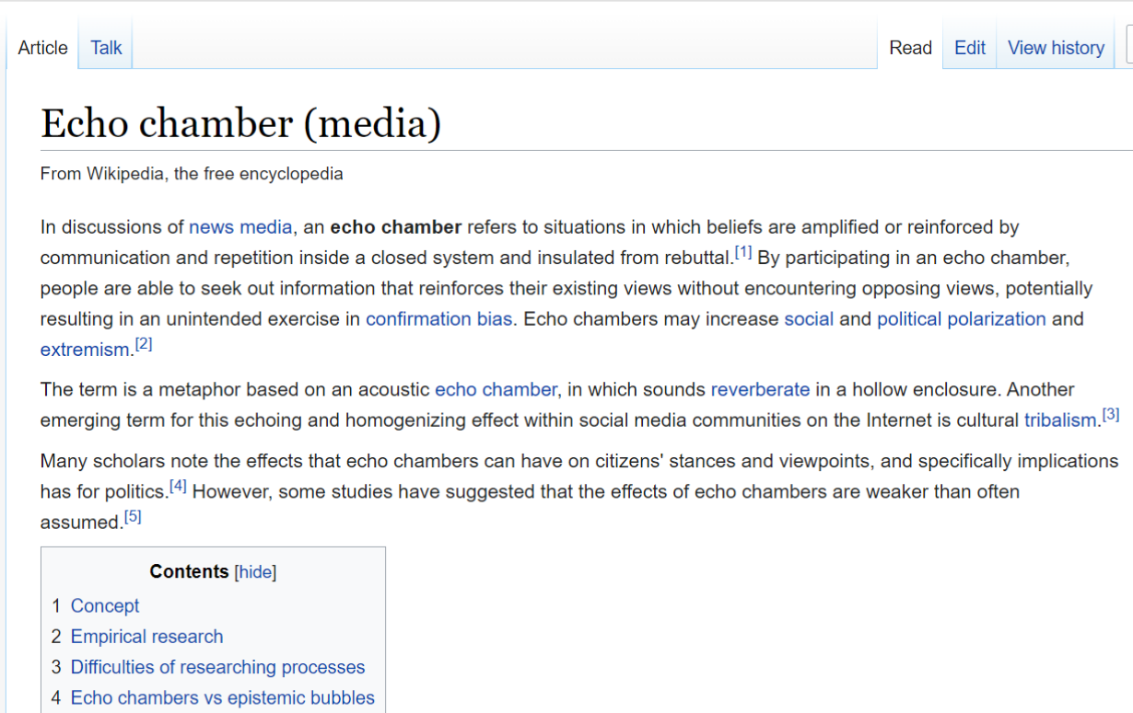
Echo chambers
Popular definition: Wikipedia
An echo chamber is an environment where a person only encounters information or opinions that reflect and reinforce their own.

Slide 7
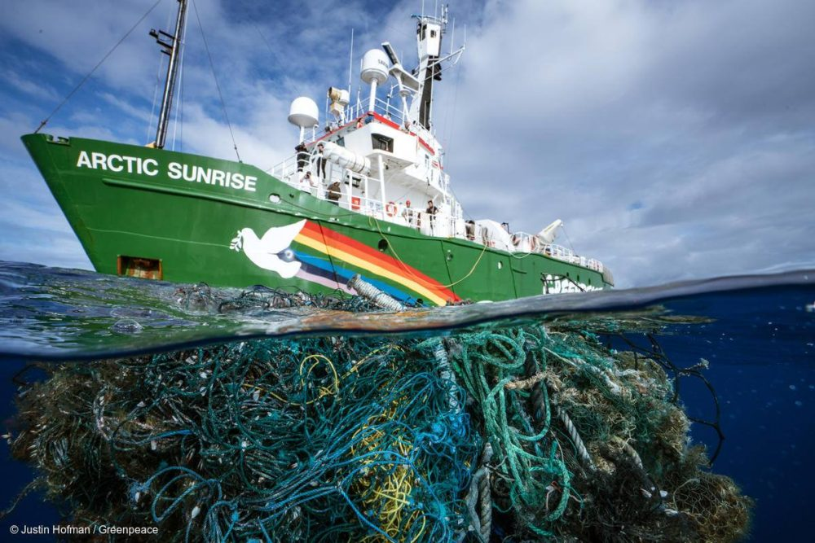
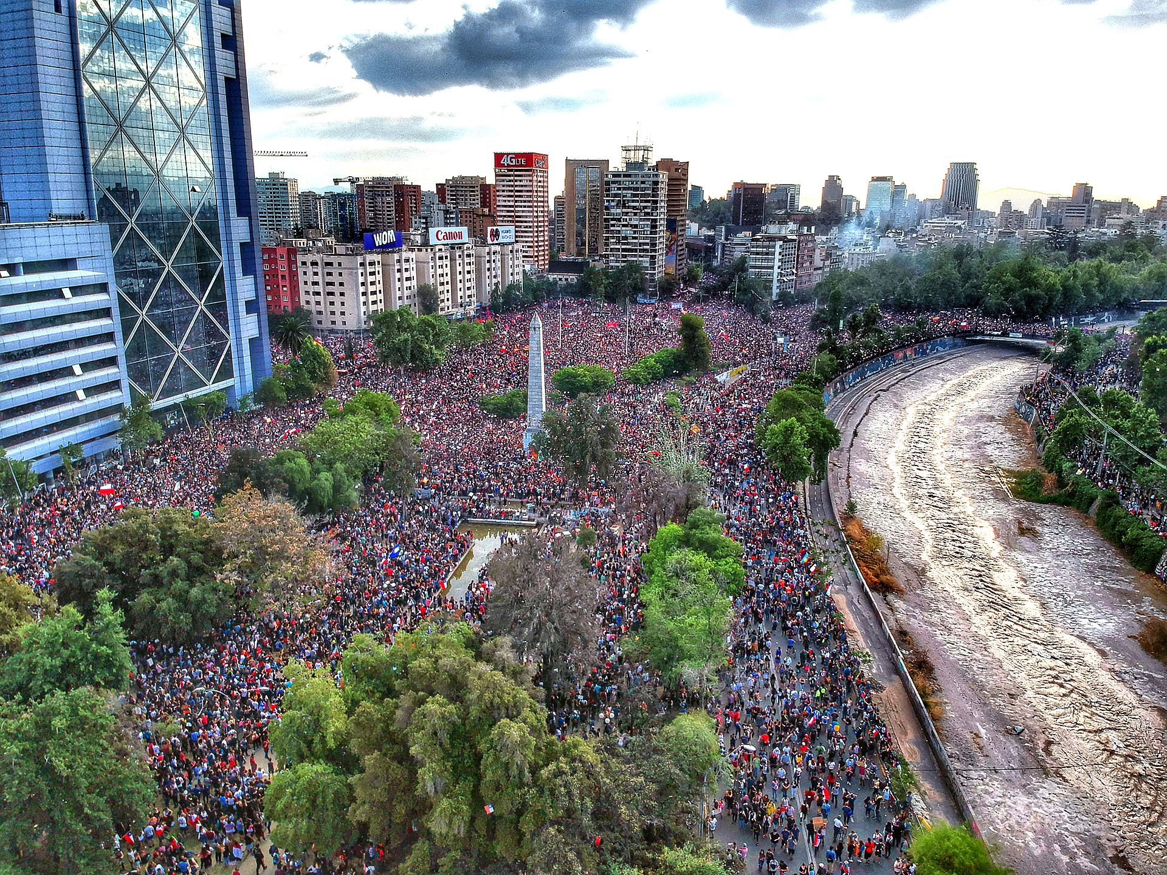
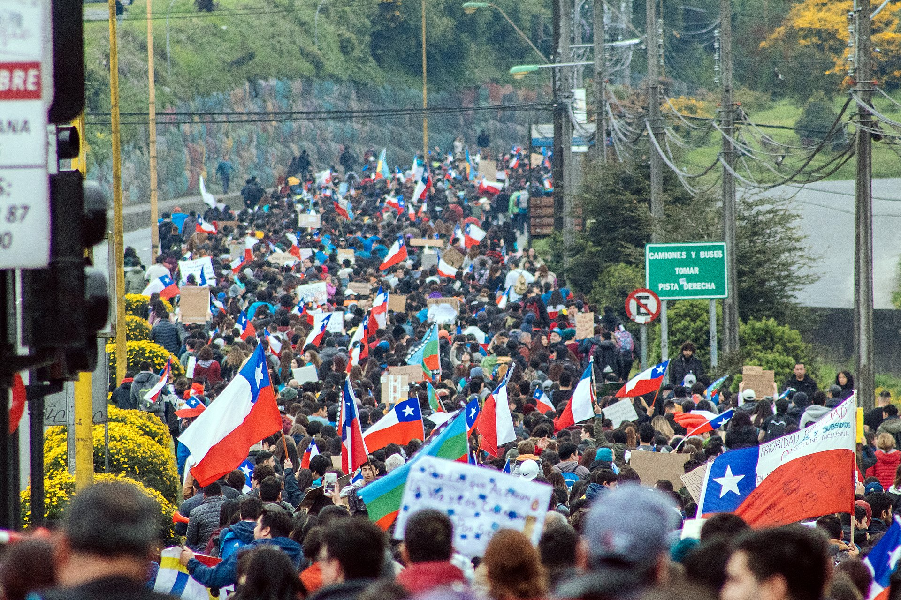
Examples
Good
Activism -> Greenpeace
Political movements -> Chile
Bad
Far-right movements that support hate crimes - White supremacist groups -> SIAN in Norway (against Islamization in Norway)
Political movements -> Taliban
Notes:
Most common examples that we use for talking about echo chambers are the most visible ones. Usually we refer to acitivist movements or certain political movements on the good side and far-right movements that are using hate speech or illegal actions and conciously spreading misinformation and fake news to achieve a certain goal on the bad side. These are the most common example – However, we must dig deeper to understand how they are created, what can we do to avoid them or conciously break out of them. In the rest of the presentation I will try to explain what is an echo chamber, how it is created and if they are examples why are not purely good or bad in addition to more specific examples.
Klimaaktivister i Olje- og energidepartementet – NRK Oslo og Viken – Lokale nyheter, TV og radio - Young climate activist in the Oil- and Energy Ministry – Good goal – not necessarly the best action. If it is not violent, it is not a problem, but it is a threat (PST – Threat evaluation 2021)
Chile 2019-2021: The cost of transports, inequalities and the costs of living. Considered to be the worst civil unrest since Pinochet. The pandemic revoked the revolution. Causes: Rise in public transport fares[2][3], Increased corruption, cost of living, privatisation, and social inequality - Goals: Reversal of public transport fares, Reforms in education, health care, and pension systems, Better wages and minimum wage increase, Resignation of President Sebastián Piñera, Draft a new constitution[4], Formation of new government
SIAN: Stop Islamisation of Norway - Wikipedia - Its stated aim is to work against Islam, which it defines as a totalitarian political ideology that violates the Norwegian Constitution as well as democratic and human values.[2] The organisation is led by Arne Tumyr, and has several thousand members and supporters

Slide 8
How do we end up in echo chambers online?

Slide 9
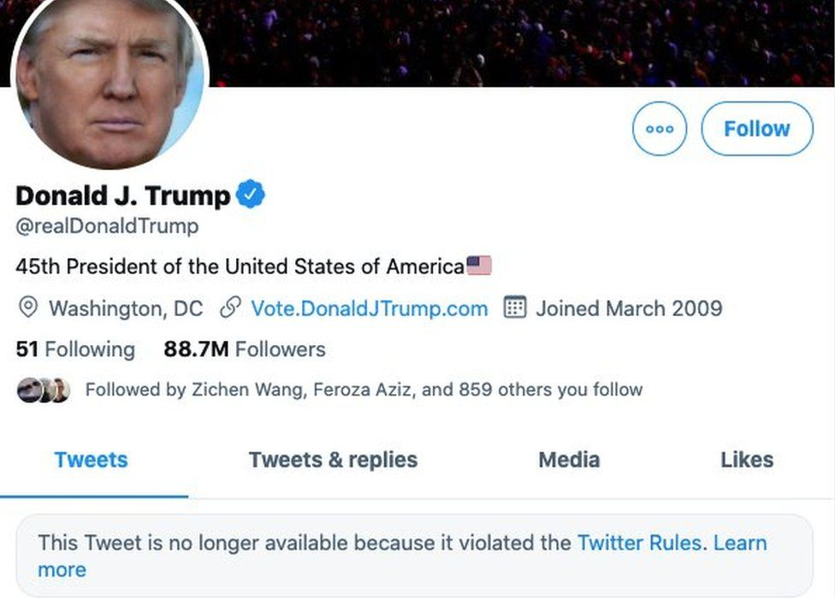
Follow your interests
Follow people: Twitter, facebook, etc.
Follow hashtags: #progun #prolife #proGod
Join Groups
https://www.reuters.com/technology/facebook-asks-are-your-friends-becoming-extremists-2021-07-01/
https://www.theguardian.com/technology/2021/feb/04/facebook-groups-misinformation
Notes:
Examples in the social media:
Hashtags on twitter or on instagram where the user can follow certain hashtags creates a knowledge bubble. If we are only exposed to a certain content and there is nor diversity in that content than
Groups on Facebook – linked articles are
All of these reinforcing the user in a certain ideology, idea, group attitude and does not let opposing views or ideas through or if it does, it will
First hashtags, groups
Examples: hashtags and groups (twitter, instagram, fb, twitter)
History of hashtag by Christoph
Facebook groups: Facebook says there are more than 400 million people in groups that they find meaningful as of April 2019, up from 100 million in February 2017. - Zuckerberg's focus on Facebook groups increases Facebook engagement (cnbc.com)

Slide 10
PART 2: What do these echo chambers look like?

Slide 11
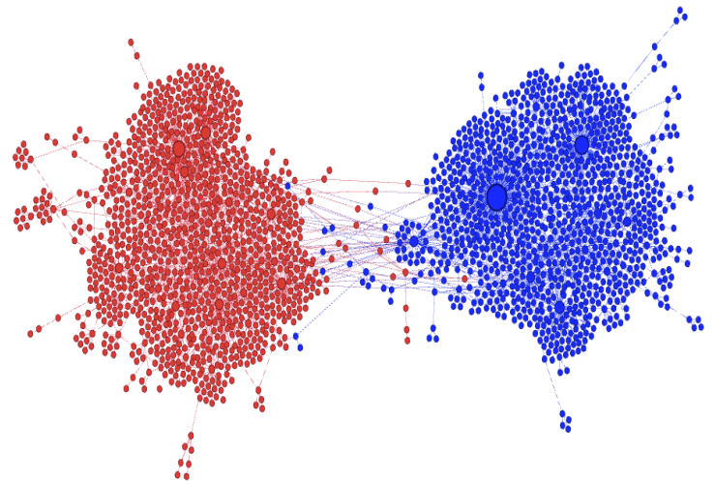
Example: Twitter echo chamber about food
#beefban
Figure shows echo-chambers formation in retweet graph on the controversial #beefban topic.
Red: people agreeing with #beefban
Blue: people disagreeing with #beefban
Source: Kumar et al., 2018 https://doi.org/10.1145/3159652.3160597
Notes:
#beefban: #BeefBan: How Indians reacted to the red meat ruling - BBC News - People in certain parts of India could face jailtime or fine if they found in possession of beef. Some people reacted very sarcastically to it and some was very supporting.
Formation of echo-chambers. Given the advent of improved recommendation algorithms which promote personalized content for easy user access and exposure, social media platforms are often party to an “echo-chamber” effect [22]. This effect primarily refers to the self-selective polarizing effect of content where people immerse themselves in social circles in such a way that they are primarily exposed to content that agree with their beliefs. For example, a political liberal might friend more liberals on Facebook, thumbs-up liberal-minded content, and thus constantly be exposed to posts and news which aligns with his worldview. The figure visualizes this echo-chamber effect on Twitter on a controversial topic of #beefban, where red and blue nodes represent users with opposing beliefs and edges represent who-retweets-whom, as shown by Garimella et al. [31]. Notice that both groups are mostly disconnected with few messages between nodes of different types. The echo-chamber effect in social networks is substantiated by Nikolov et al. [67] by demonstrating that the diversity of sources (links) clicked by users is significantly lower on social media platforms than in general search engines. Several studies have studied the effects and causes of echo-chambers. Quattrociocchi et al. [78] demonstrated that such resulting echo-chambers can serve to polarize the user’s viewpoints by means of confirmation bias and lead to less diverse exposure and discussion between unaligned users. The resulting echo-chambers can contribute to the spread of false information by lowering the bar for critical fact-checking. Moreover, Trilling et al. [102] and Zajonc [116] posited that the perceived accuracy of false information increases linearly with the frequency of exposure of a participant to the same false information. This suggests that familiarity with repeatedly shared content (highly common and expected in echo-chambers) increases the perceived accuracy of the content, irrespective of its credibility. This calls for research on how to create effective techniques to break echo-chambers and slow down false information spread.

Slide 12
Example: Twitter echo chamber about elections
Polarized and segregated network on Twitter.
The network visualizes retweets of political hashtags from the 2010 US midterm elections
Colors represent political preference: red for conservatives and blue for progressives
Source: Sasahara et al., 2021 Social influence and unfollowing accelerate the emergence of echo chambers | SpringerLink
Notes:
Fig. 1 Example of a polarized and segregated network on Twitter. The network visualizes retweets of political hashtags from the 2010 US midterm elections. The nodes represent Twitter users and there is a directed edge from node i to node j if user j retweeted user i. Colors represent political preference: red for conservatives and blue for progressives [20]. For illustration purposes, only the nodes in the k = 3 core are visualized. See Methods for more details
Figure 1 shows what an information difusion network with those two features looks like. Human factors such as homophily [16–18] (the tendency to form ties with similar people) and social infuence [19] (the tendency of becoming more similar to somebody as a result of social interaction) are often thought to drive the emergence of polarization and segregation.

Slide 13
How can I assess whether or not I am in an echo chamber?

Slide 14
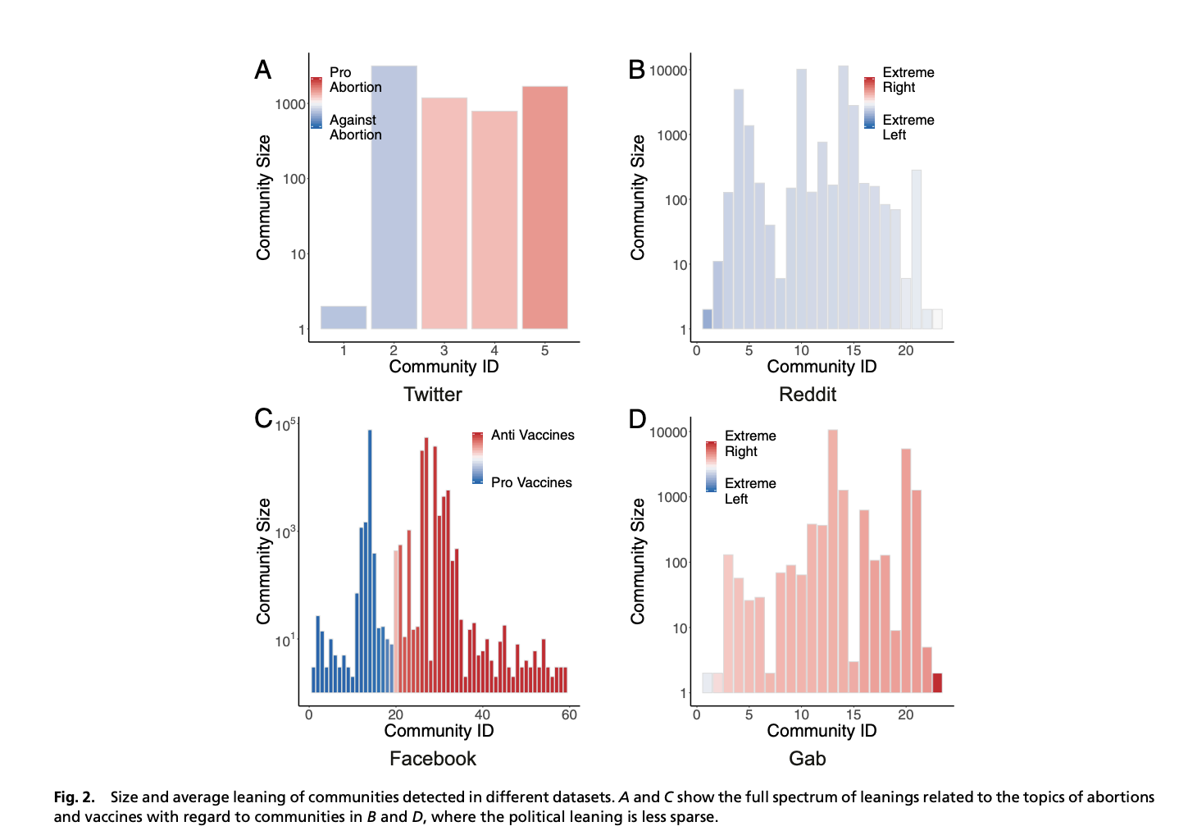
Measuring magnetism
M. Cinelli, G. De Francisci Morales, A. Galeazzi, W. Quattrociocchi, M. Starnini, PNAS 118, e2023301118, (2021).
Ref: https://www.nature.com/articles/d43978-021-00019-4#ref-CR1

Slide 15
Part 3: What can we do about echo chambers?

Slide 16
How do I tackle “echo chambers” in my own research
Understand how people behave
Recommender Systems
Theories
e.g. social
psychology
Behavioral
Analytics
Modeling
Information Science
Data
Social Network Data
Online Communities

Slide 17
.. and in MediaFutures?

Slide 18
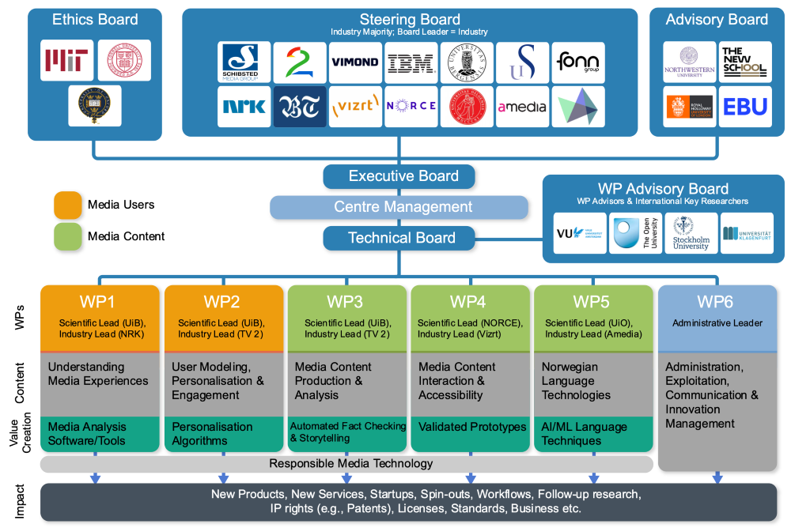

Slide 19
Recommender Systems! Where do we find them?

Slide 20
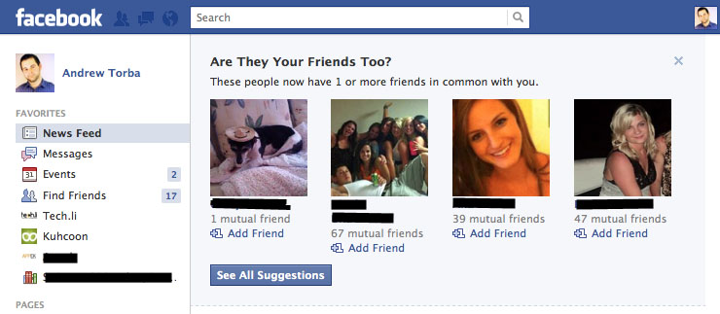
Facebook: Friend Recommender
Source: https://techli.com/facebook-rolls-out-in-your-face-friend-recommendations/18468/

Slide 21
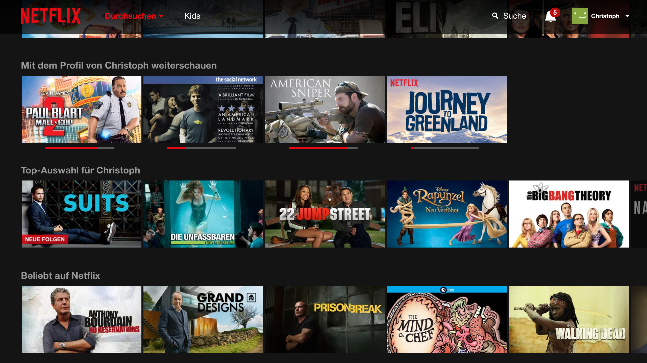
Netflix: Movie Recommender System

Slide 22
Amazon: Book Recommender

Slide 23
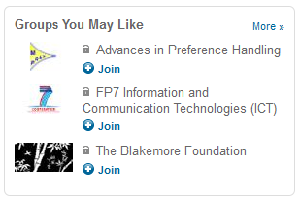
LinkedIn: Job & Group Recommender

Slide 24
Youtube: Video Recommender

Slide 25
Google: Search Recommender

Slide 26
Recommending ”healthier” news alternatives

Slide 27
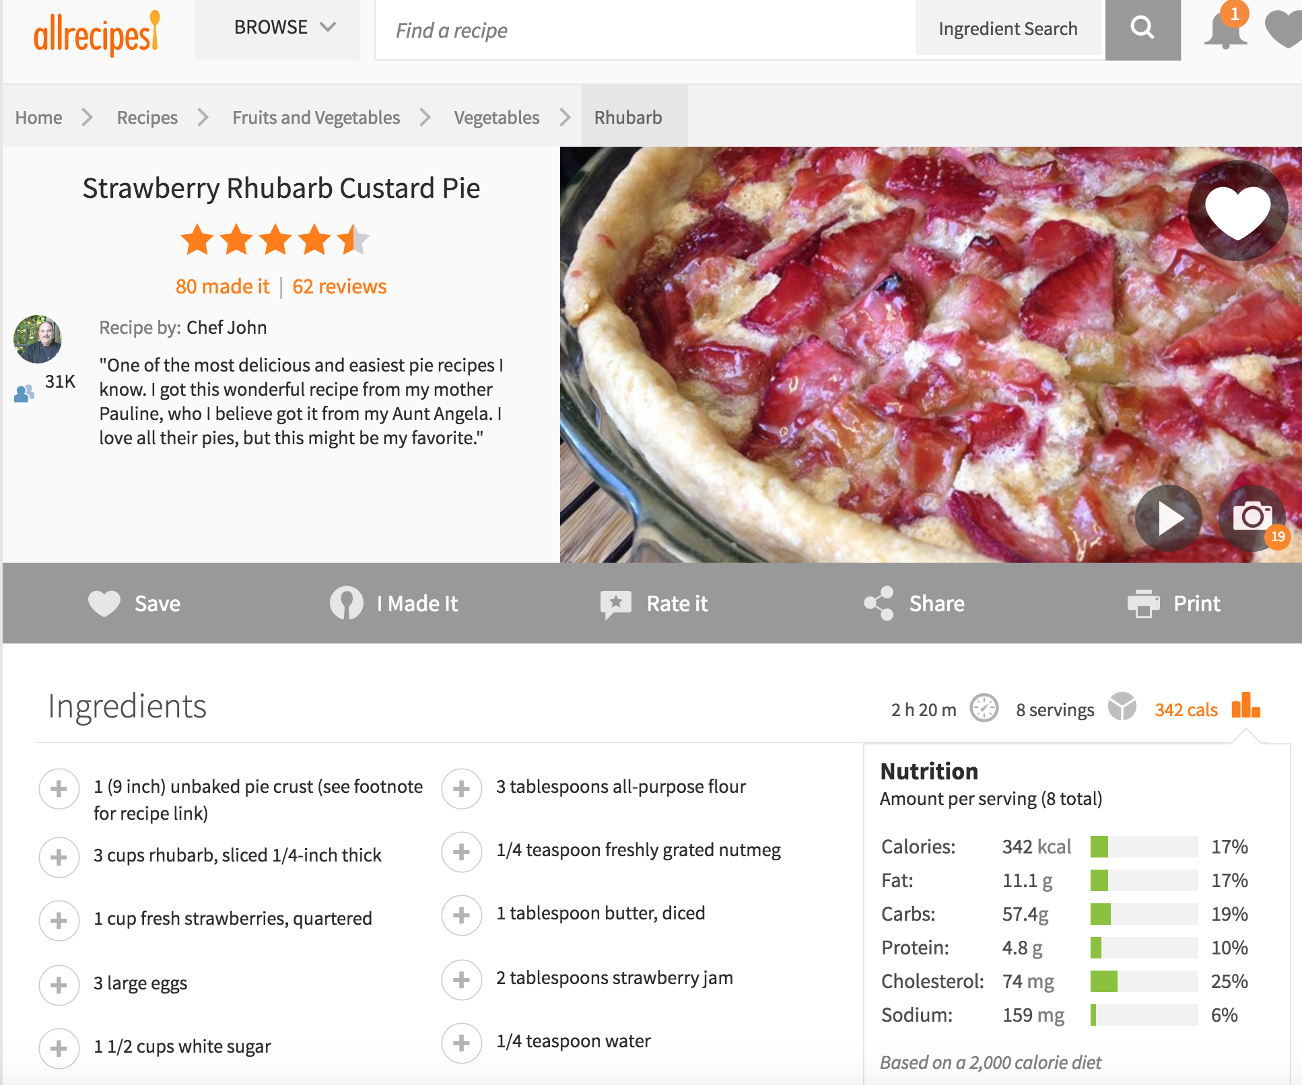
Choosing food online!
Image
Title
User
feedback
Ingredients
Nutrition

Slide 28
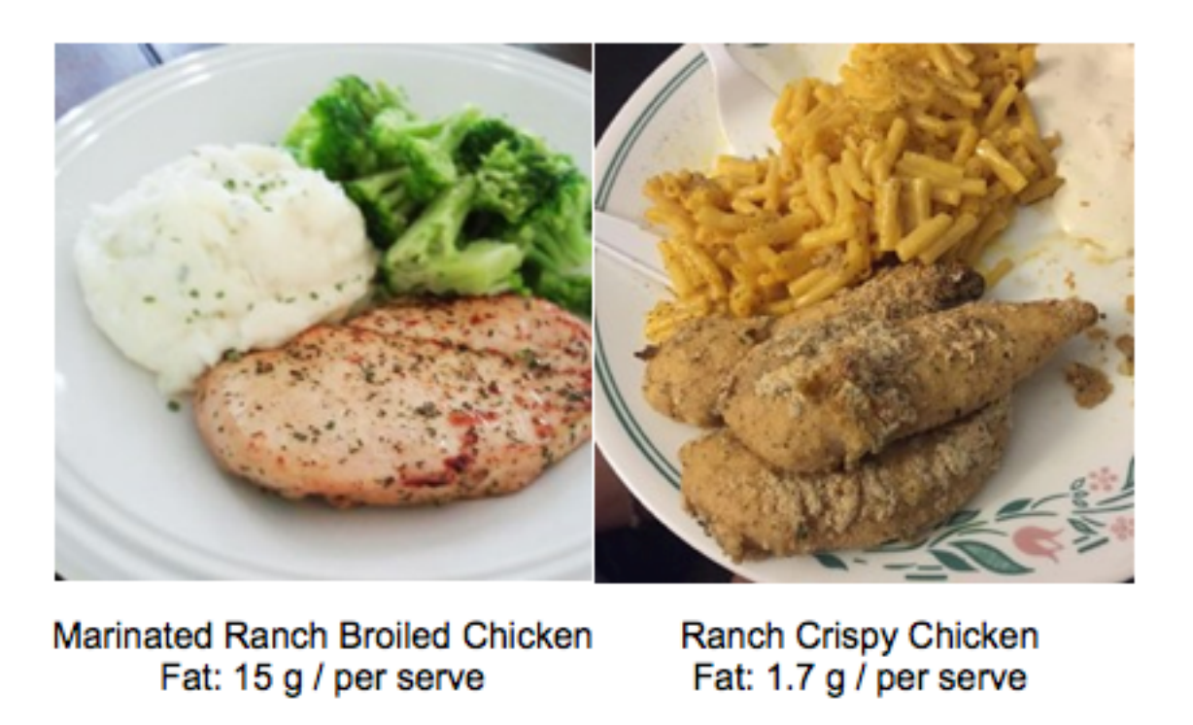
Which of the two foods would you choose?

Slide 29
User Study Design
10 random
pairs
Mturk
Study
Page
Post
Questionair
…
Study Code

Slide 30
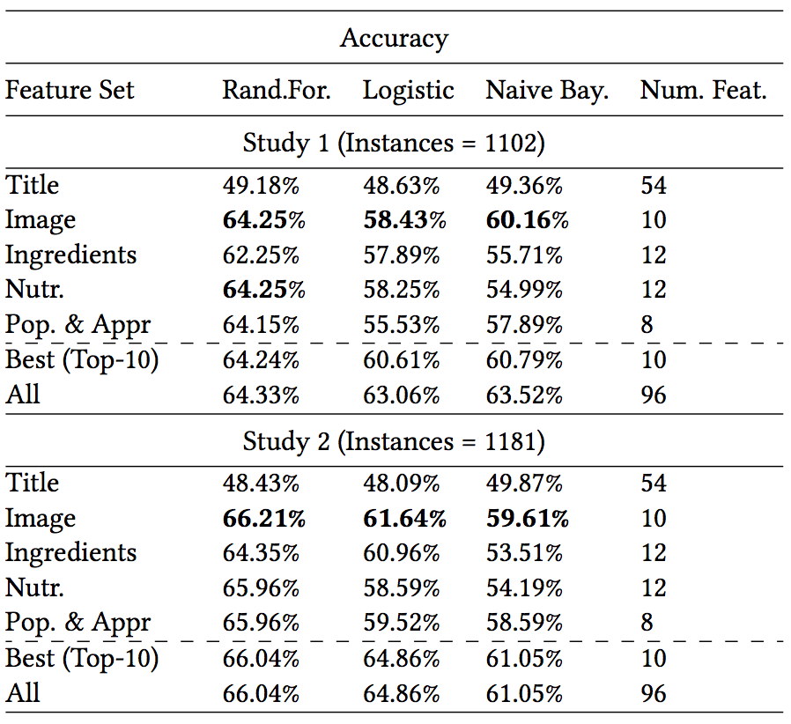
Predicting Choices
Main finding:
Image is key
The more attractive image a recipe has the more likely it will be selected
User Study 1
User Study 2

Slide 31
Altering choices (!)

Slide 32
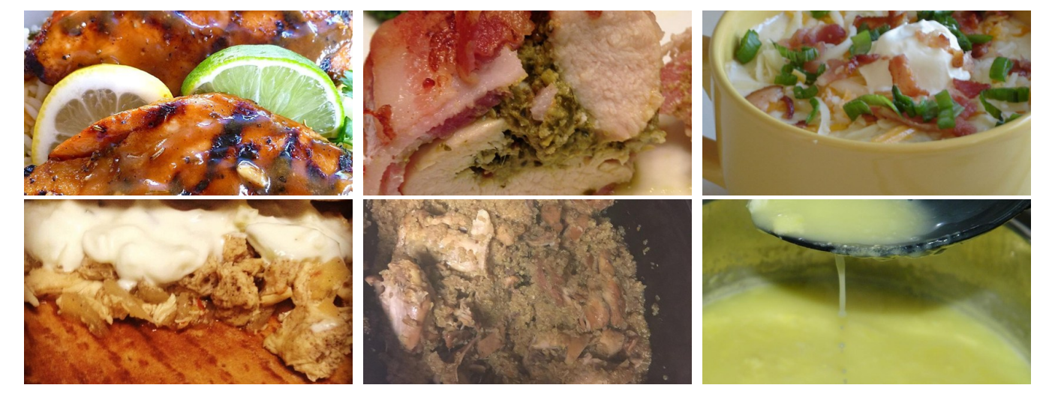
Nudging People Towards Healthy Food Choices
Developed an algorithm that can nudge people towards healthy food choices through images ☺
Less fat
More fat
Exploiting Food Choice Biases for Healthier Recipe Recommendation. Elsweiler, D.*, Trattner, C.* and Harvey, M. (* equal contribution). In Proceedings of the ACM SIGIR Conference (SIGIR), 2017.

Slide 33
Can we do the same with news items?

Slide 34
How do people process news items?

Slide 35
Which cues do people use?

Slide 36
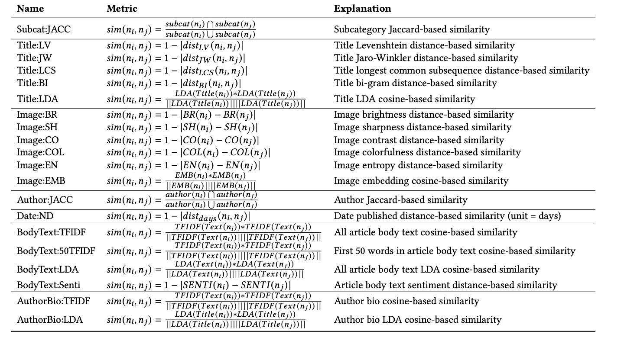
How can we model similarities?

Slide 37
How do these models actually correlate with human estimates?

Slide 38
Correlations with human estimates
1 = 100% correlation
Poor performance

Slide 39
What does that mean?
Models are not capturing human perception well
Recommended content is actually diverse
no fear with view point amplification?
If we are not able to capture similarities well, how can we then diversify content?

Slide 40
Let us come to an end…

Slide 41
Main take aways
Echo chambers are everywhere
Similarity main indicator for being in an echo chamber
Recommender technology might help to burst chambers
However, much more research in this direction is needed…

Slide 43
Contact!
Prof. Dr. DI Christoph Trattner BSc
Email: trattner.christoph@uib.no
Web: https://christophtrattner.com
Twitter: @ctrattner

