Slide 1
WP4
Media Content Interaction & Accessibility
Annual meeting 2021

Slide 2
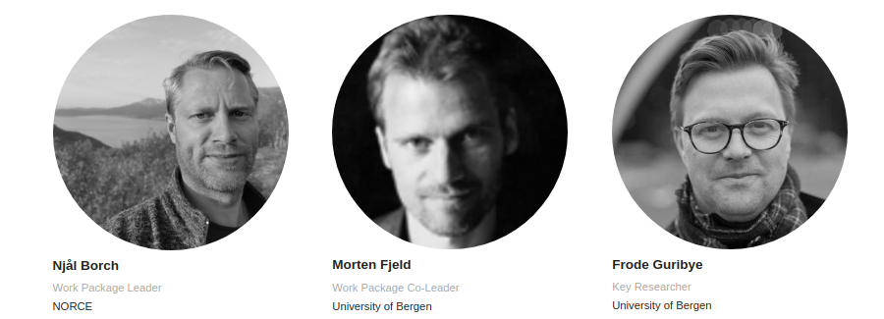
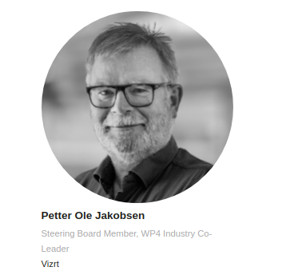

Slide 3
Objective
Develop methods and technologies for interaction between media content and users, both humans and computerised, and to provide personalised, adapted media experiences to all users regardless of their technical aptitude and personal needs.

Slide 4
We don’t want to change all the formats, workflows and services in order to get further!
Explore possibilities, not limits.

Slide 5
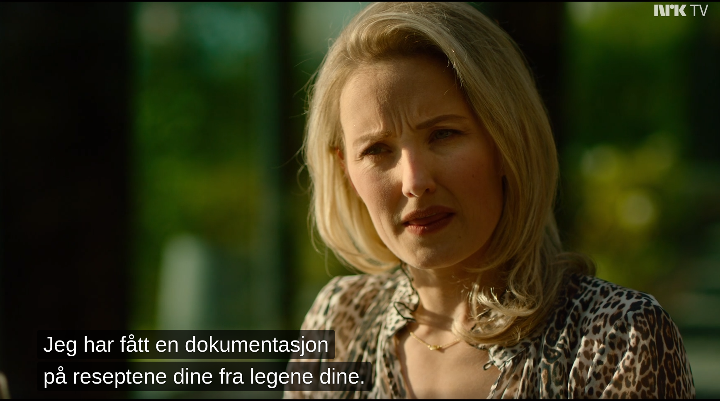
Challenge 1 - Subtitles
Who said it?

Slide 6
Challenge 1 - Subtitles
Context?
No context
Depends on
image

Slide 7
Challenge 1 - Subtitles
Context?
Dependent on audio
(or the text itself)
Upcoming legal requirement to subtitle recorded radio (podcasts)

Slide 8
Challenge 1 - Subtitles
Our approach
Avatar
Personal
color
High viz
option

Slide 9
Challenge 1 - Subtitles
Under the hood
Subtitle formats lacks “who”
Combine manuscript or transcript with subtitles
Manual quality control
Guess based on language (who speaks like this)?
Re-sync with audio (Voice Activation Detection)
More work:
Voice recognition (AI)
Use color palette actively

Slide 10
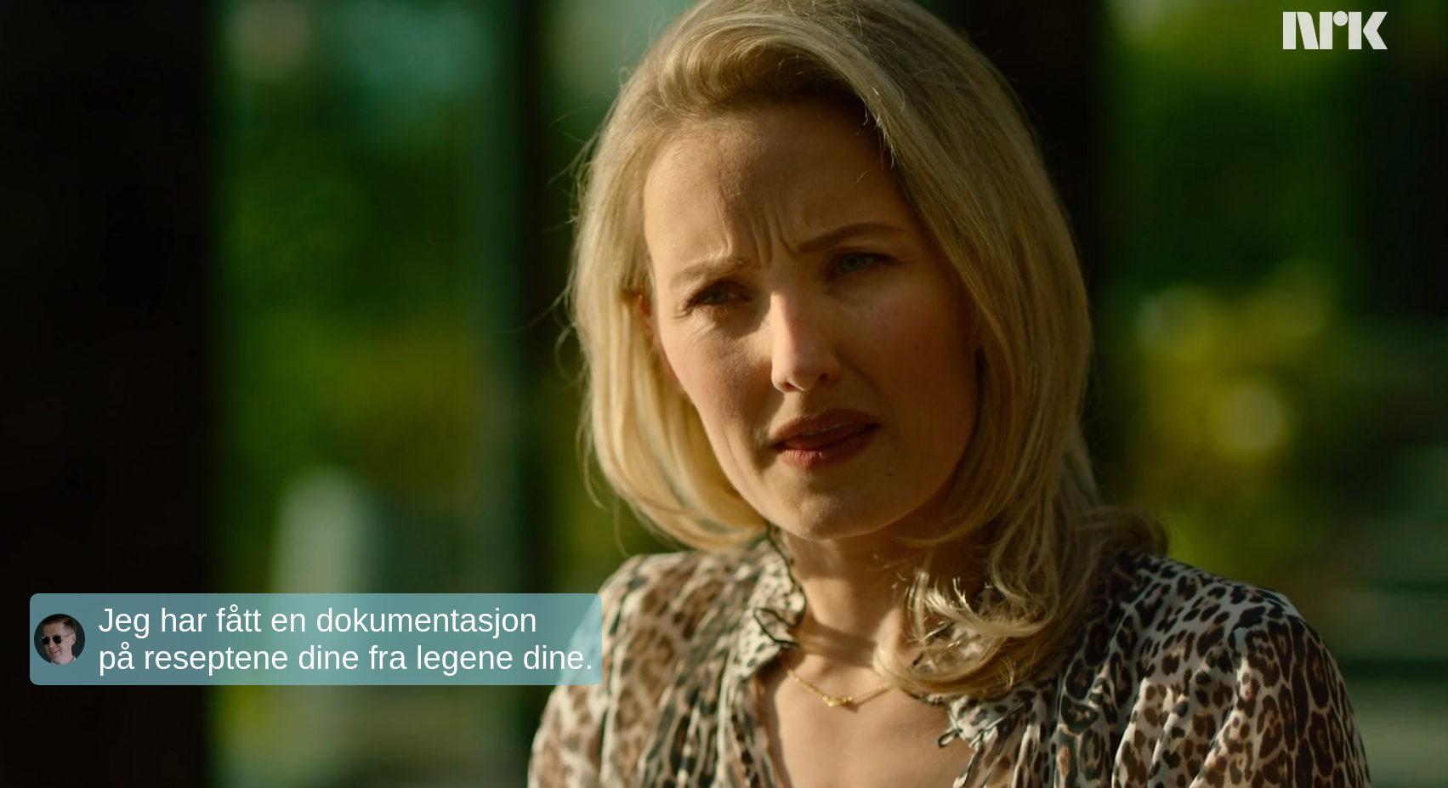
Challenge 1 - Subtitles

Slide 11
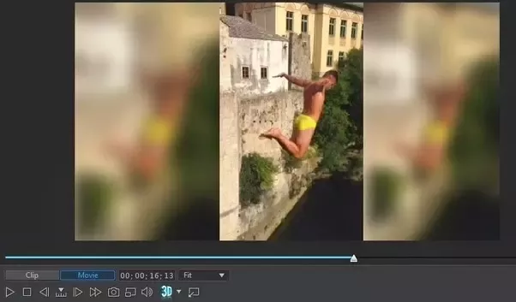
Challenge 2 - Player adaptation
Render correct on whatever screen
Also includes graphics...
Adapt to needs
Audio descriptions
Sign language
Subtitles
Multiple screens
Personal stuff on personal device

Slide 12
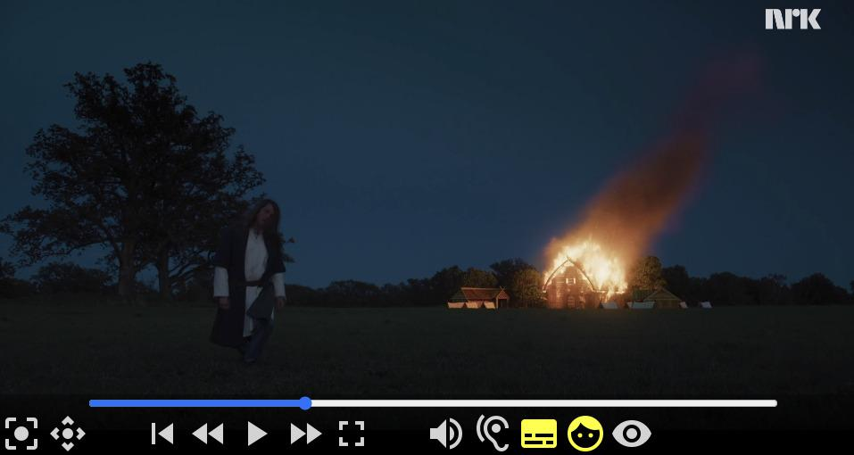
Flexible player
Resources (http):
Video
Audio
Sign language (video)
Audio descriptions
Audio track
Textual (TTS)
Subtitles
WebVTT
JSON (contextual)
Positioning
Scene changes
Voice Activation Detections (VAD)
Emotions
Resources (websockets):
Positioning
Emotions
Subtitles (basic)

Slide 13
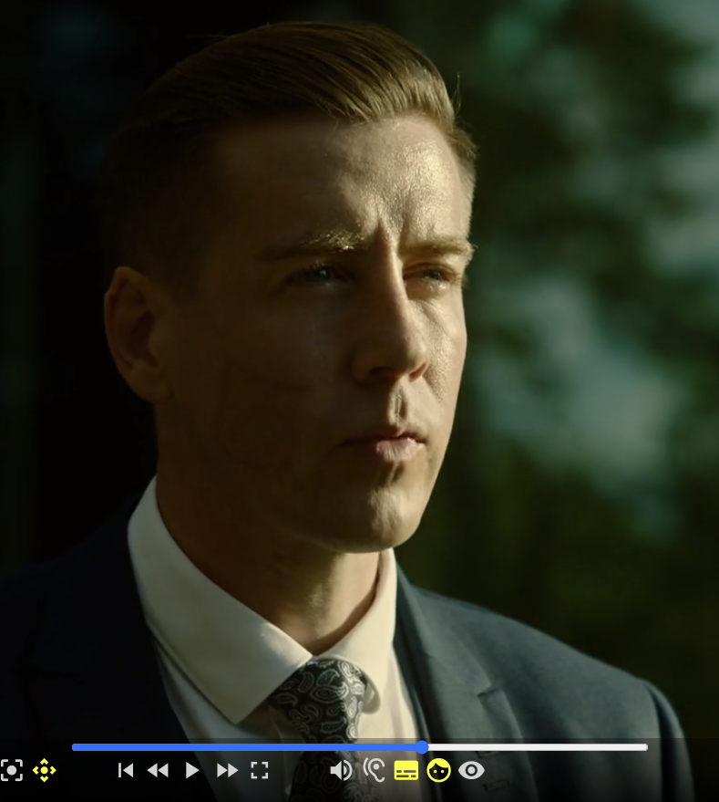
Flexible player, selected features
Toggle combinations of resources
Dynamic aspect ratio
Direct cut and smooth panning
Dynamic placement of PIP
Alpha-channel video overlay (Chrome, Firefox)
Multi-device synchronization
Adjust subtitle display time (chars/sec)
Adjust subtitle display size
Auto-pause if TTS is active (textual AD)
Standard keyboard controls
Exports all data, also with timed events (extend!)
Can easily replace video element with other player

Slide 14
Flexible player
WP4 Player
Video
Element
Video
Element
Timing object & Sequencers:
TIMINGSRC
https://webtiming.github.io/timingsrc/
Audio
Element
Timing
Object
Content
Sequencer
Subtitle
Sequencer

Slide 15
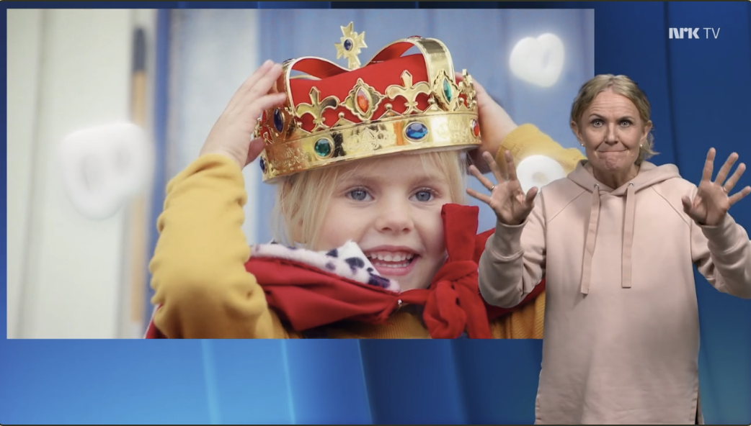
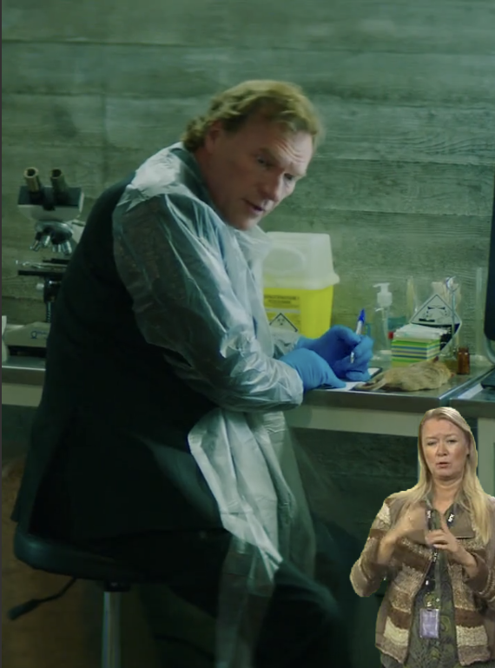
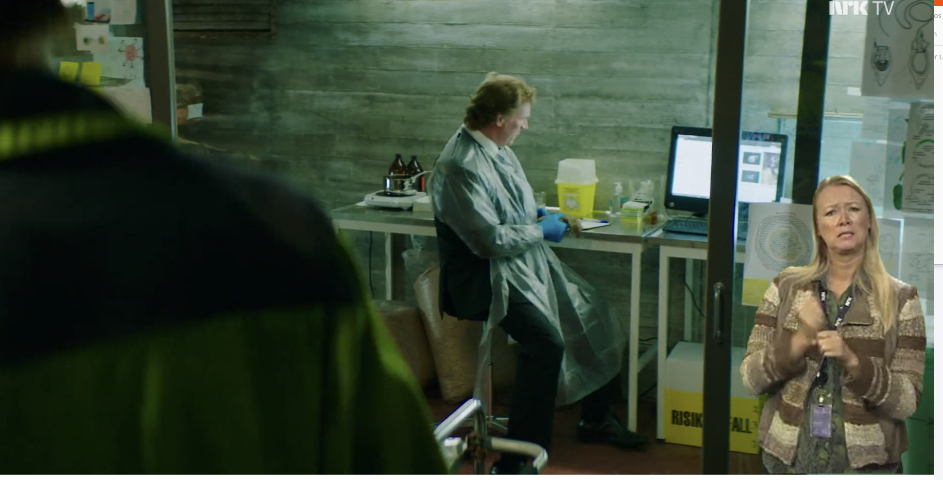
Challenge 2 - Player adaptation
Adapts aspect ratio
Overlaid on video
Uses full screen
NRK Tegnspråk
Egen “del” av NRK.no

Slide 16
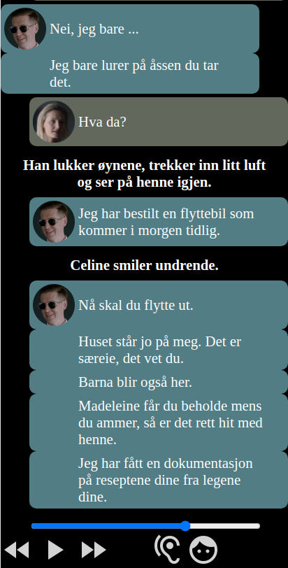
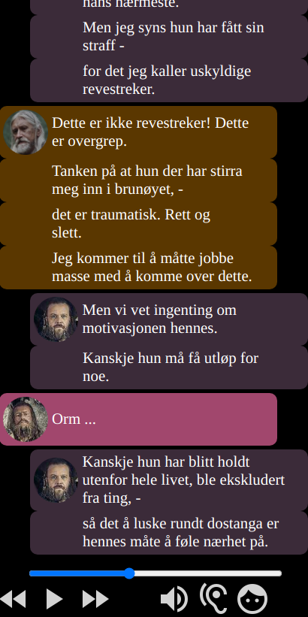
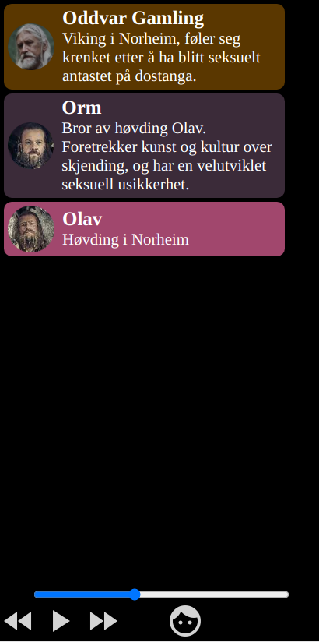
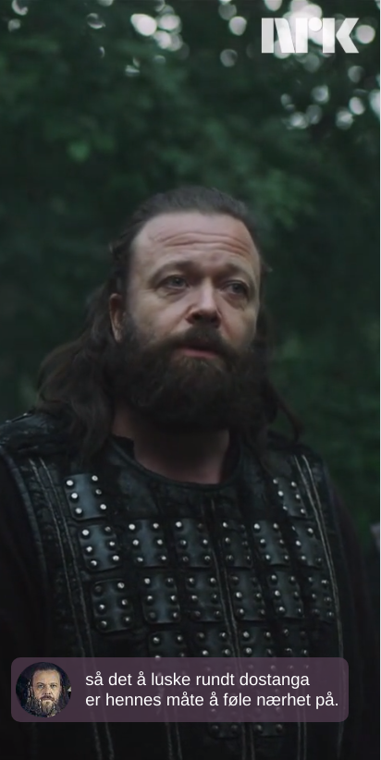
Second screens
Subtitle transcripts (last 60 seconds)
Cast information (current scene)
Subtitles + cropped video

Slide 17
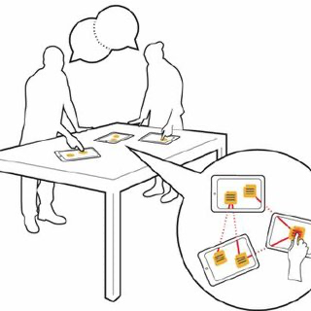
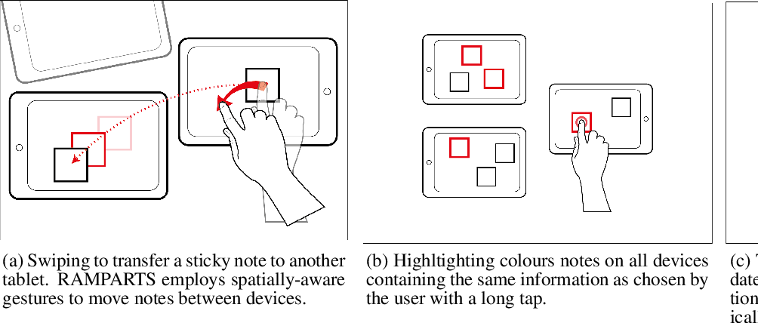
Example UI Solutions for Second Screens (Wozniak et al., RAMPARTS, CHI 2018)

Slide 18
Open questions
User testing
Second screens
One-way Interaction
Fancy subs
Dynamic aspect ratio
Personalization
Synchronization
Cognitive load
Building relations
Informative
Interactive
Navigation
Collaborative viewing
Devices without screens?
Navigation
Personalization
Deep dive (interactive datasets, e.g. vote results)
Automation
Sync requirements
Two-way Interaction
AI image analysis
AI sound analysis
Meta-data from production
More sources?
audio/video
video/video
video/info
video/text
audio/text
interactive/content
Voting
Games
Discussions
Quiz

